Slide 1
Dead languages reborn in assembly: NLP for ancient traditions
FLAIRS, Special Track on Natural Language Processing of Ancient and Other Low–Resource Languages
Kyle P. Johnson, Ph.D. • May 23, 2017

Slide 2
Overview
The ancient world vs. modern disciplines
Philology & AI
Classical Language Toolkit

Slide 3
The ancient world vs. modern disciplines

Slide 4
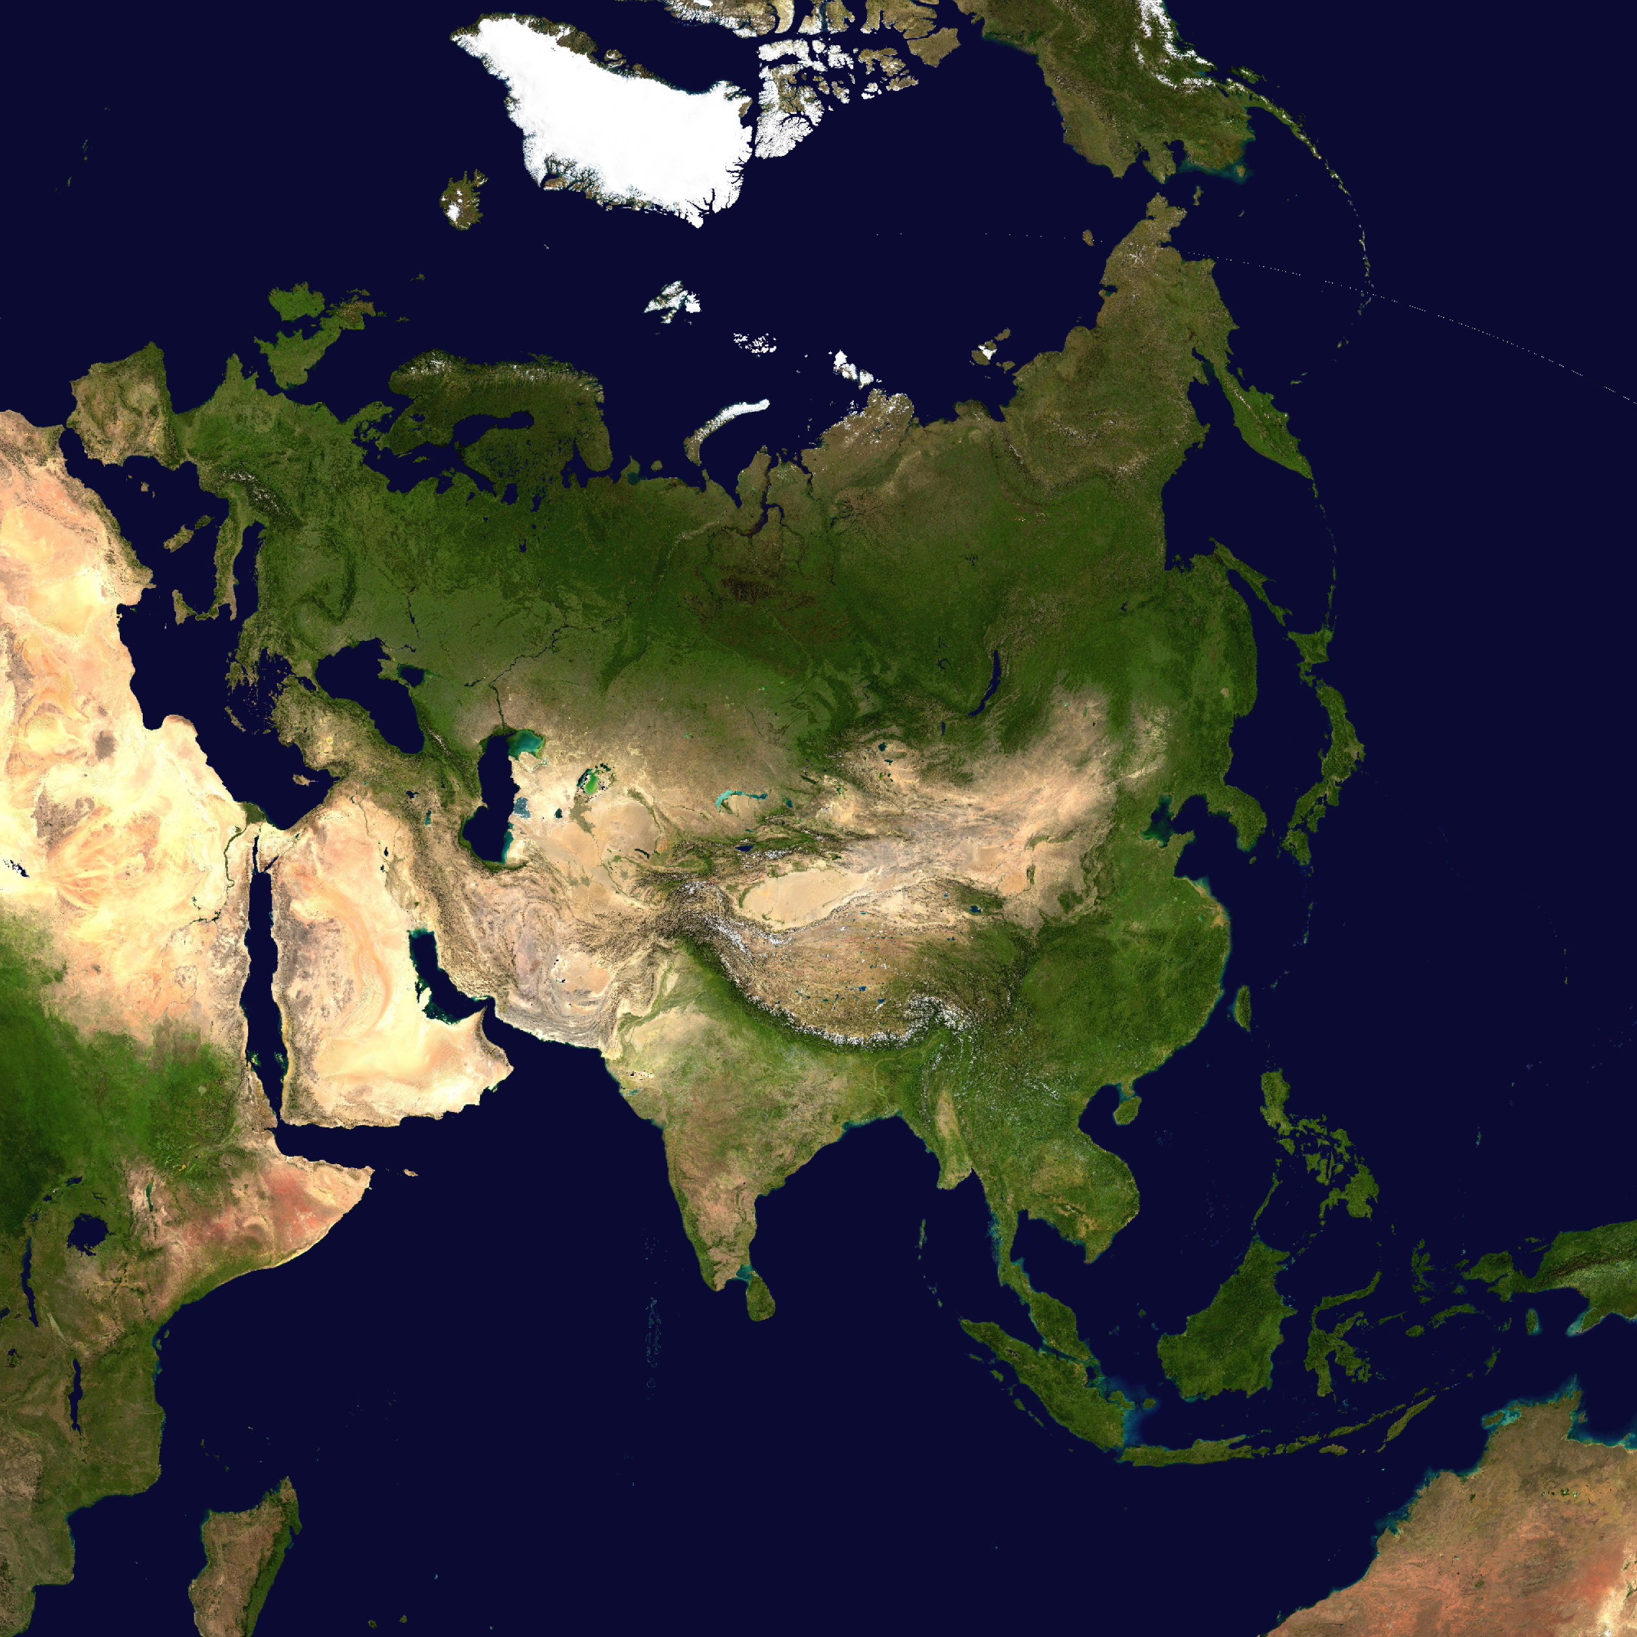

Slide 5
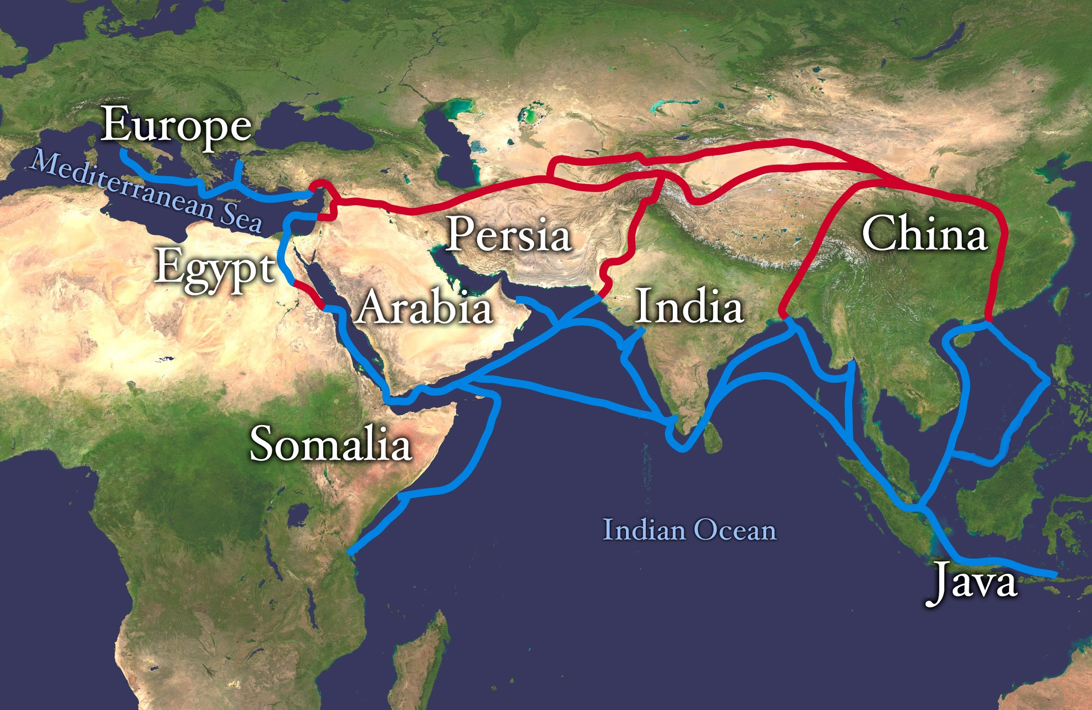

Slide 6
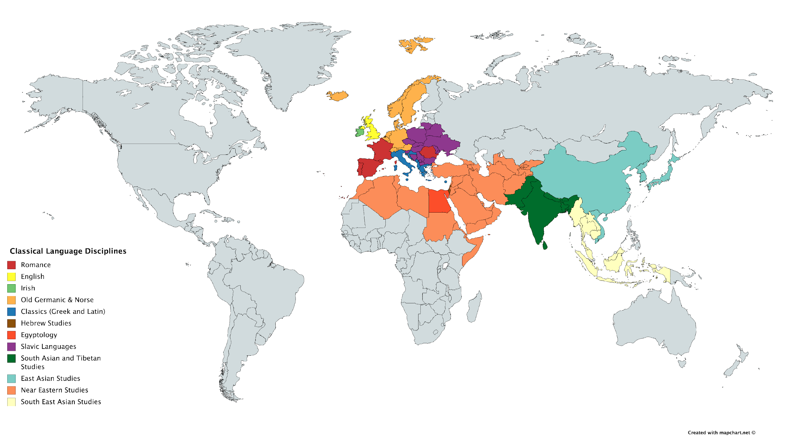
Notes:
These disciplines used to organize the world have become silos; participants do not converse w/ one another; doubt me? Answer this: Can a member of a discipline get tenure for scholarship on cross-culture interactions?
https://mapchart.net/world.html

Slide 7
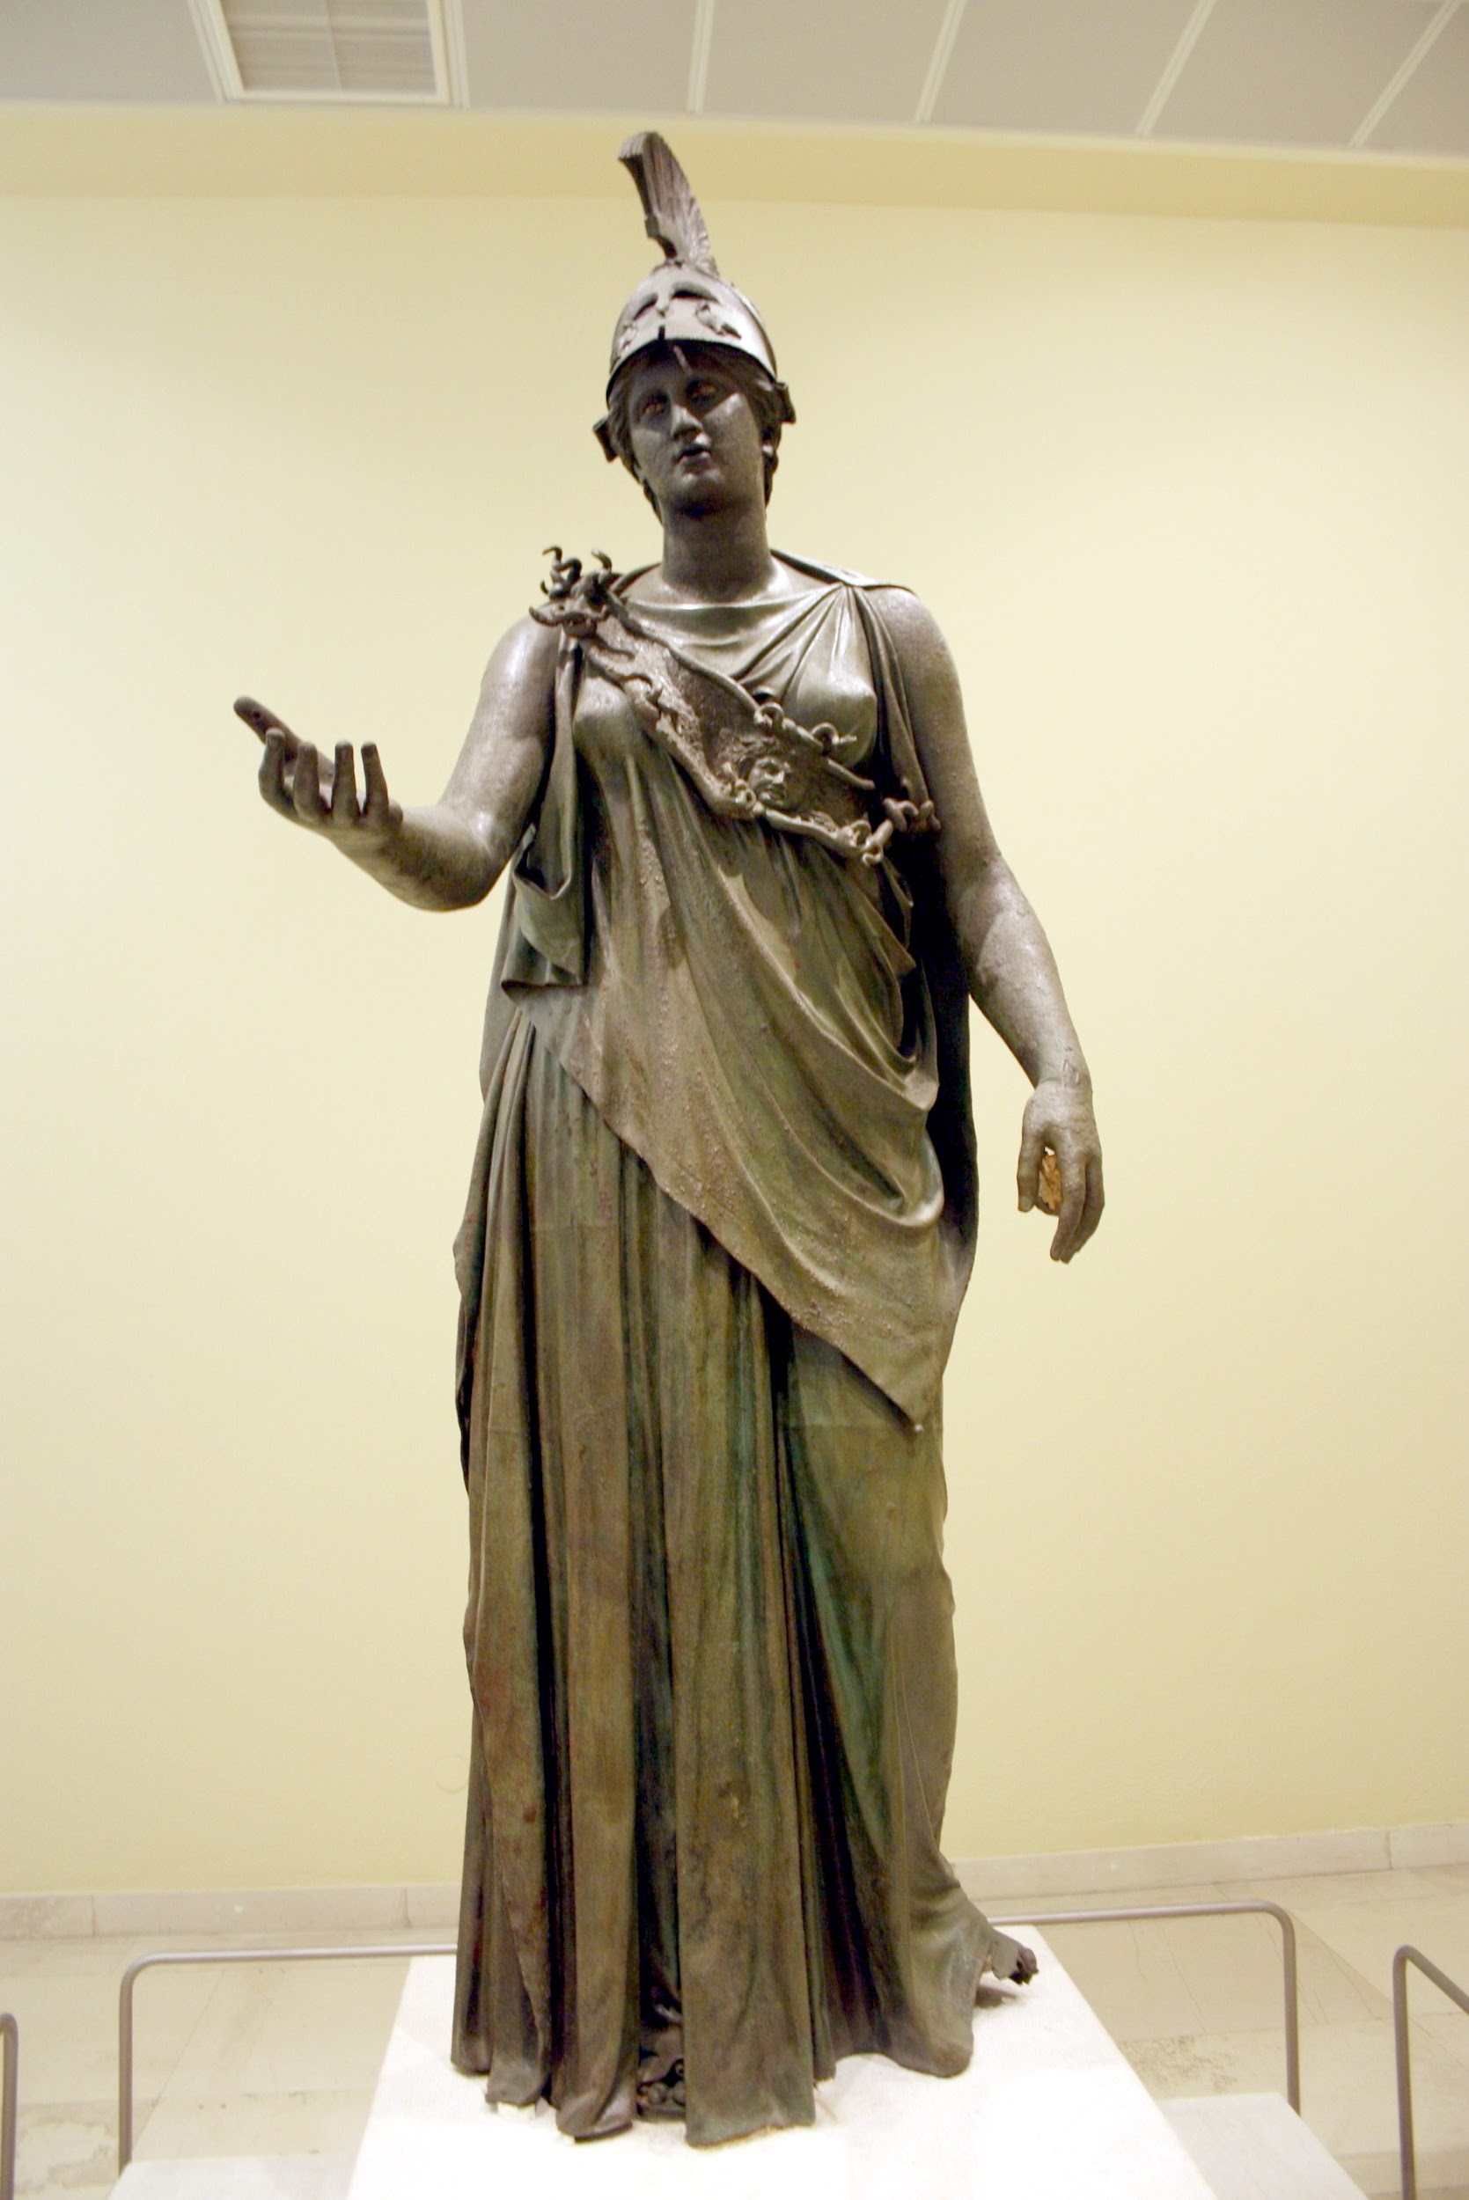
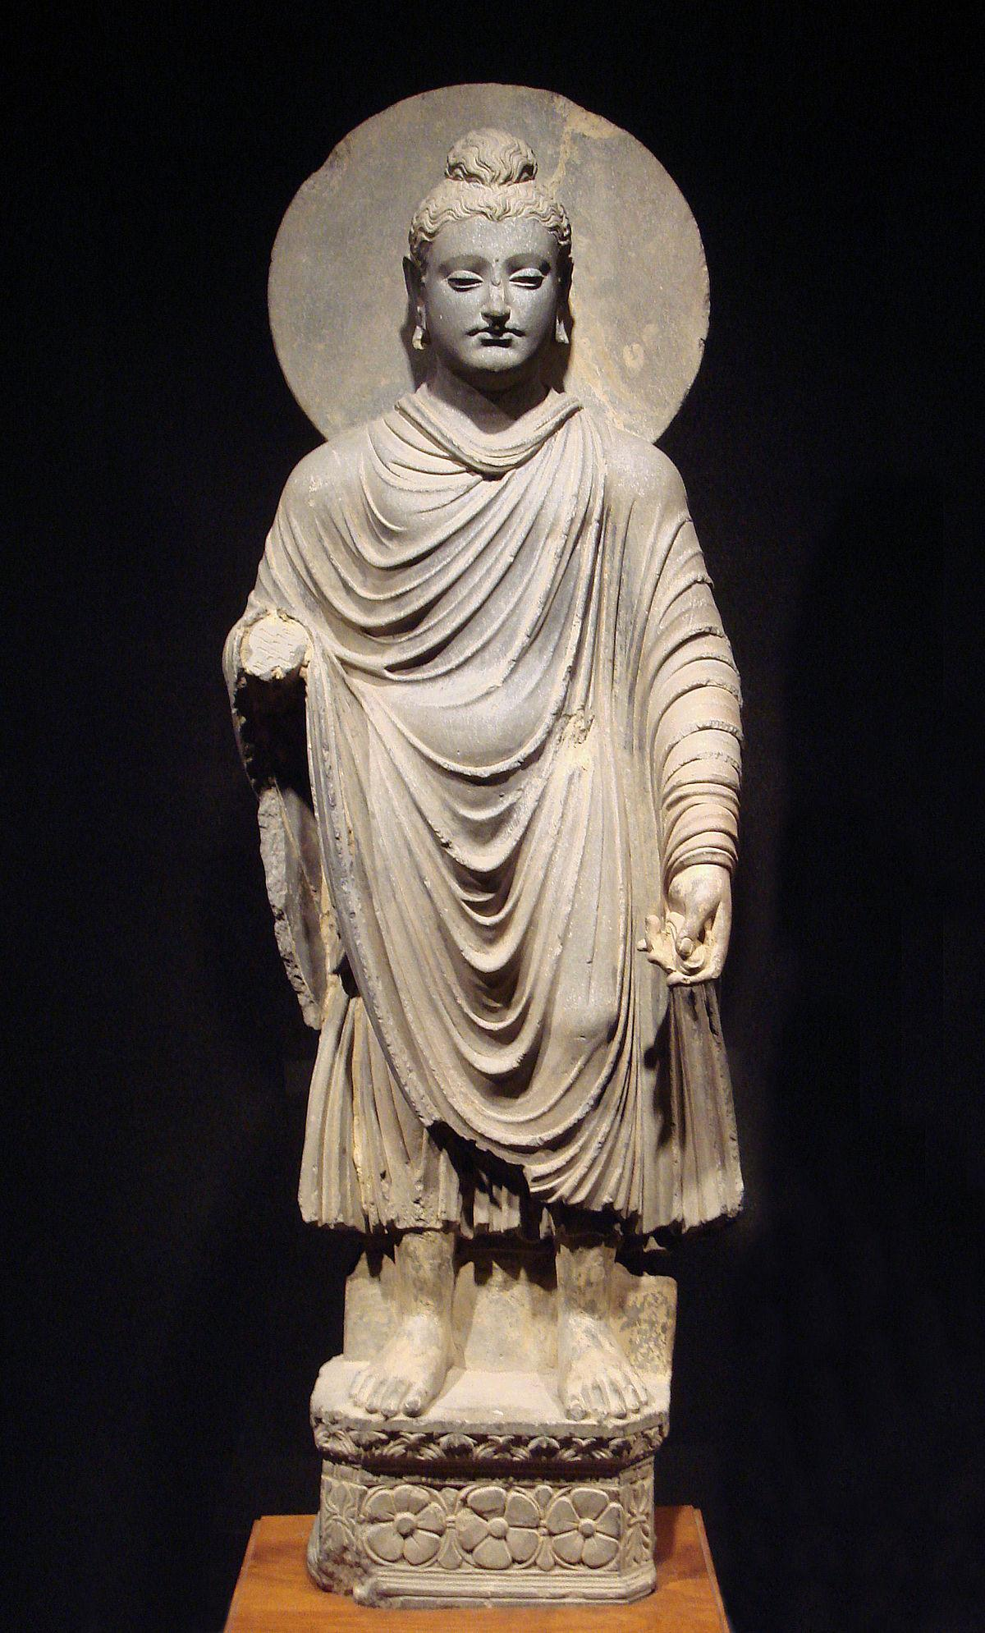
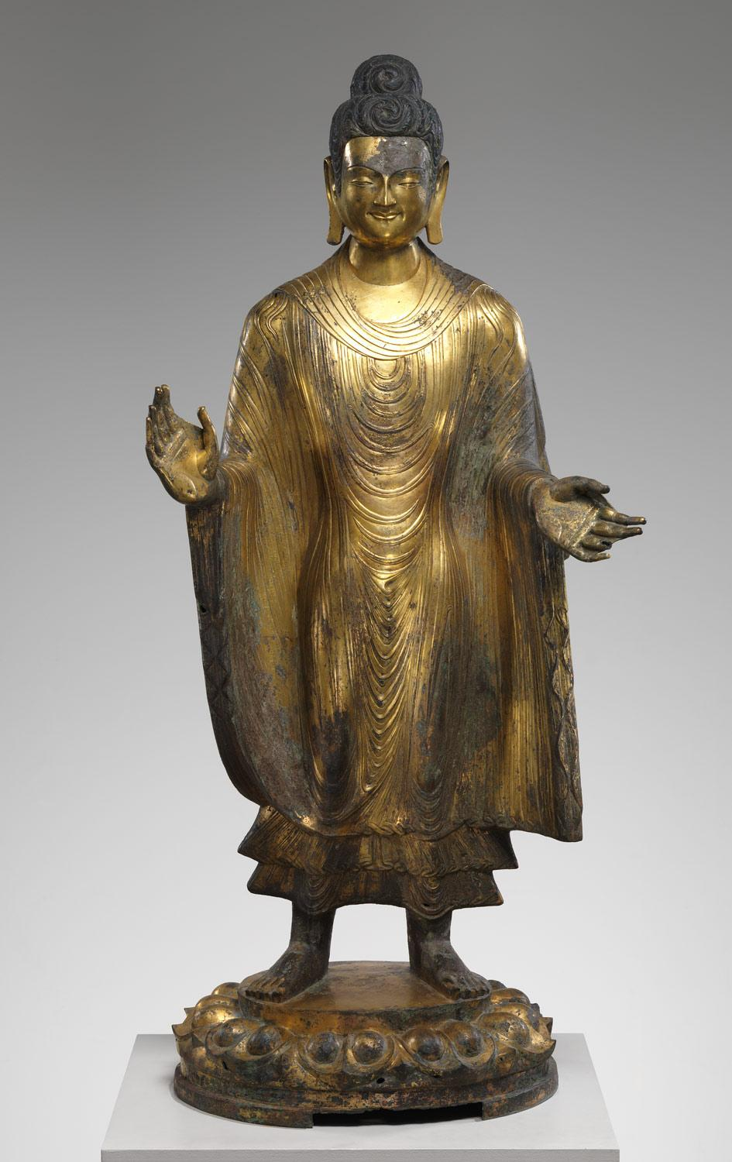
Notes:
Peiraetus Athena, 4th c BC
Gandhara: 1st-2nd century AD
Chinese: 486 AD
Sculpture from Greece to India to China
https://upload.wikimedia.org/wikipedia/commons/4/4e/7347_-_Piraeus_Arch._Museum%2C_Athens_-_Athena_-_Photo_by_Giovanni_Dall%27Orto%2C_Nov_14_2009.jpg
https://upload.wikimedia.org/wikipedia/commons/thumb/b/b8/Gandhara_Buddha_%28tnm%29.jpeg/1200px-Gandhara_Buddha_%28tnm%29.jpeg
http://www.metmuseum.org/toah/images/hb/hb_26.123.jpg [http://www.metmuseum.org/toah/works-of-art/26.123/ ]

Slide 8
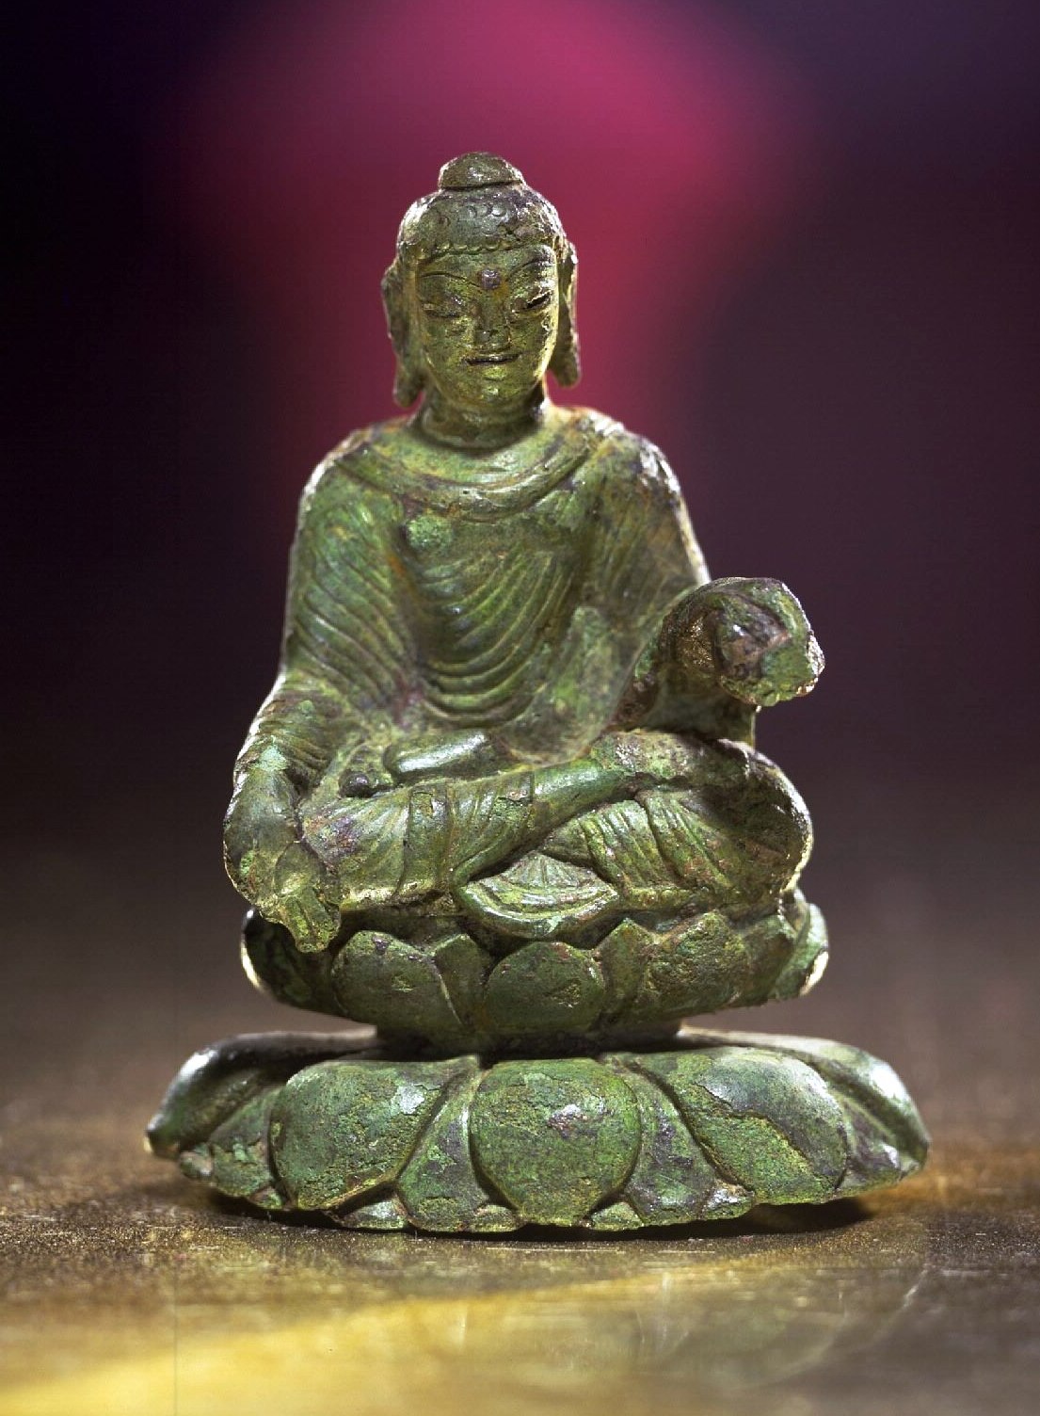
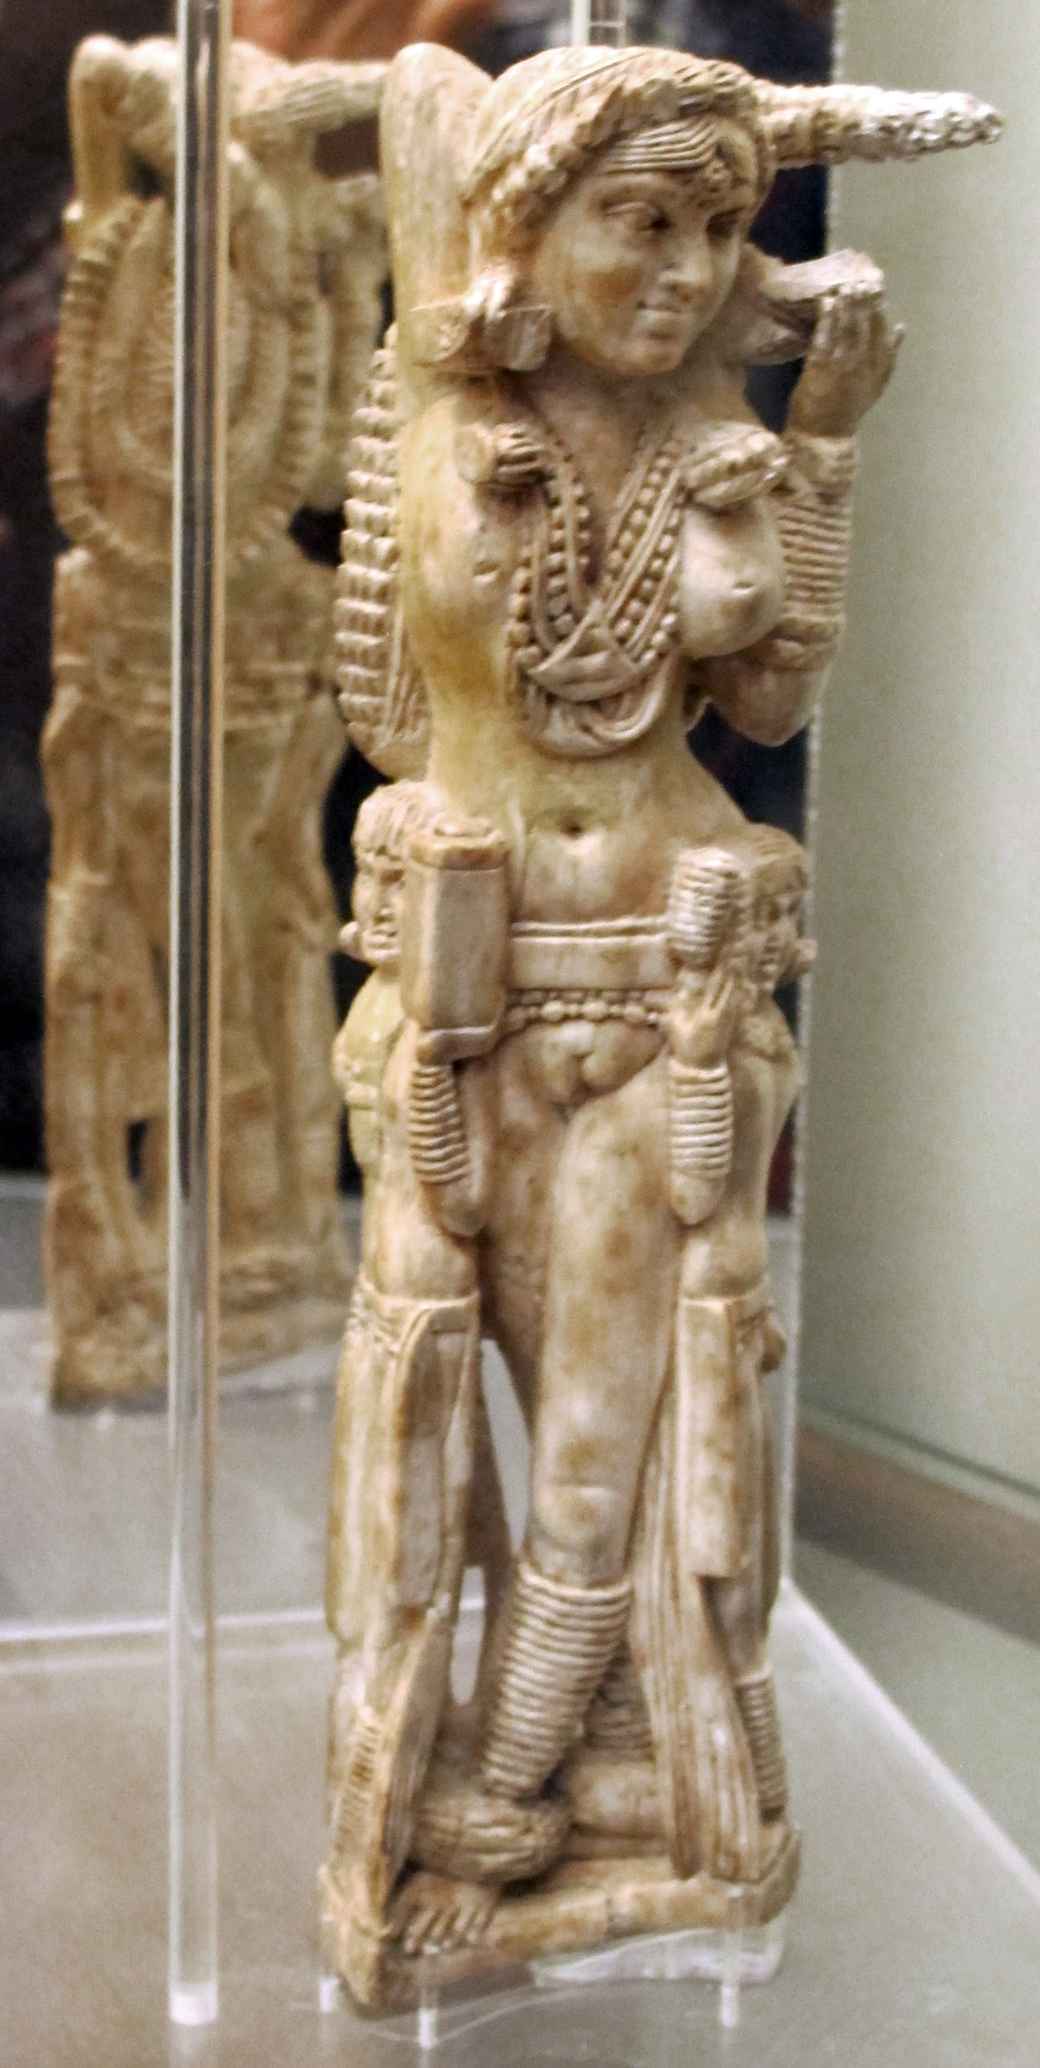
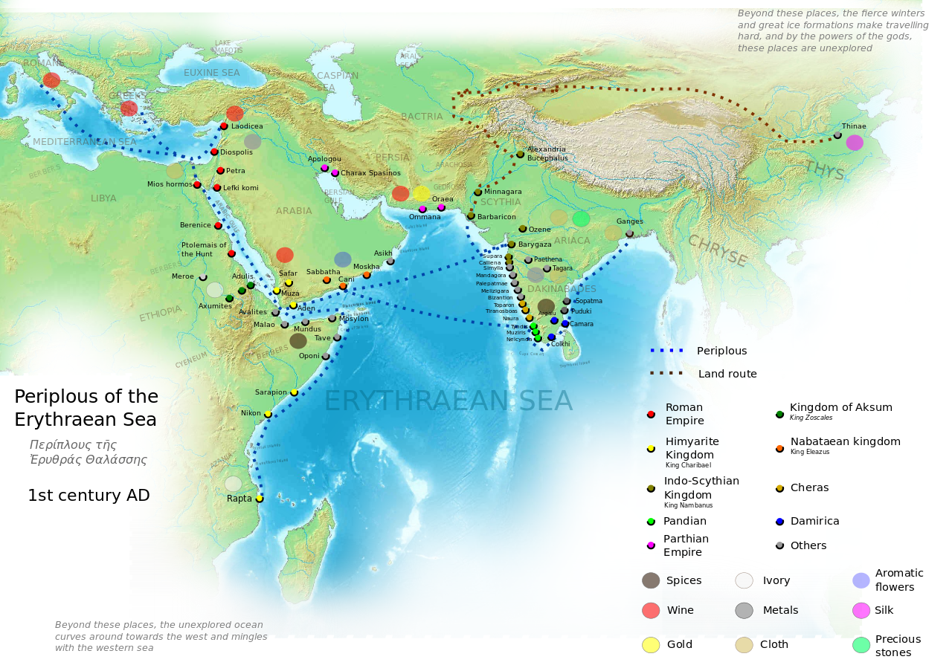
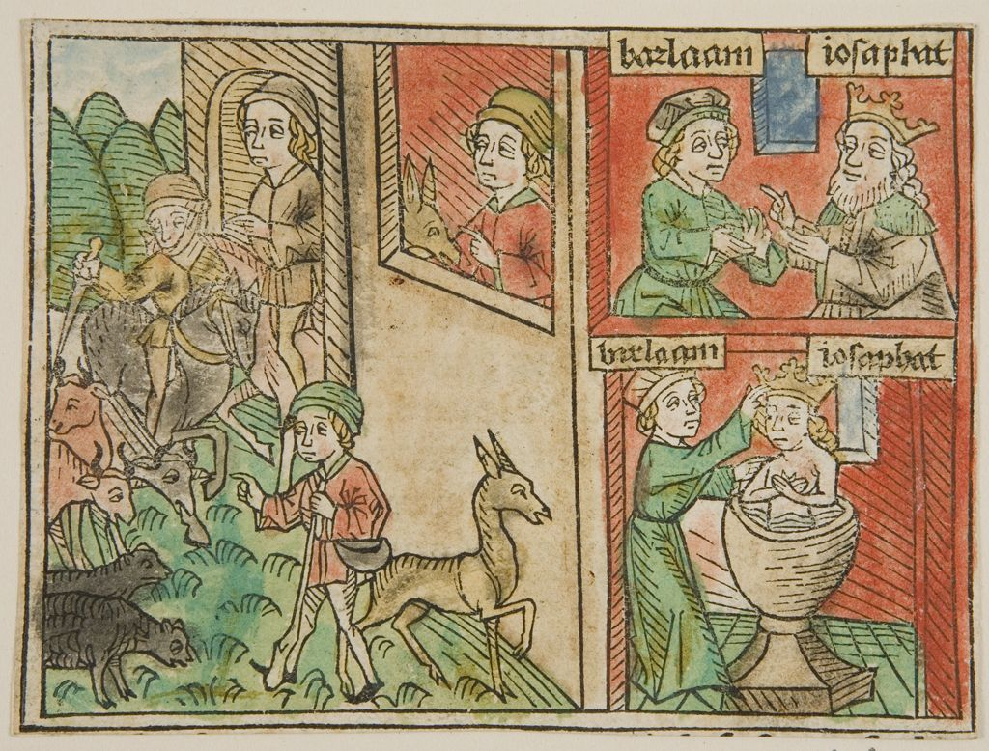
Notes:
Statue: 5th century, likely coming from Kashmir, Northern India
Found in 1954, in small town (Helgo, at Lake Malaren, of what was a Viking trading hub from 6th-11th centuries AD
* “Pompeii Lakshmi”, but really yakshi, a female tree spirit that represents fertility
* in Secret Museum
Pompeii terminus is 79 AD; from Bhokardan, In
Periplus of the Erythraean Sea
Barlaam & Josaphat: version told in Shakespeare's The Merchant of Venice
http://ids.lib.harvard.edu/ids/view/20492393?width=3000&height=3000
https://www.lionsroar.com/wp-content/uploads/2015/04/4995358503_647ab411cf_o.jpg
https://en.wikipedia.org/wiki/Barlaam_and_Josaphat
https://commons.wikimedia.org/wiki/File:Statuetta_indiana_di_Lakshmi,_avorio,_da_pompei,_1-50_dc_ca.,_149425,_02.JPG

Slide 9
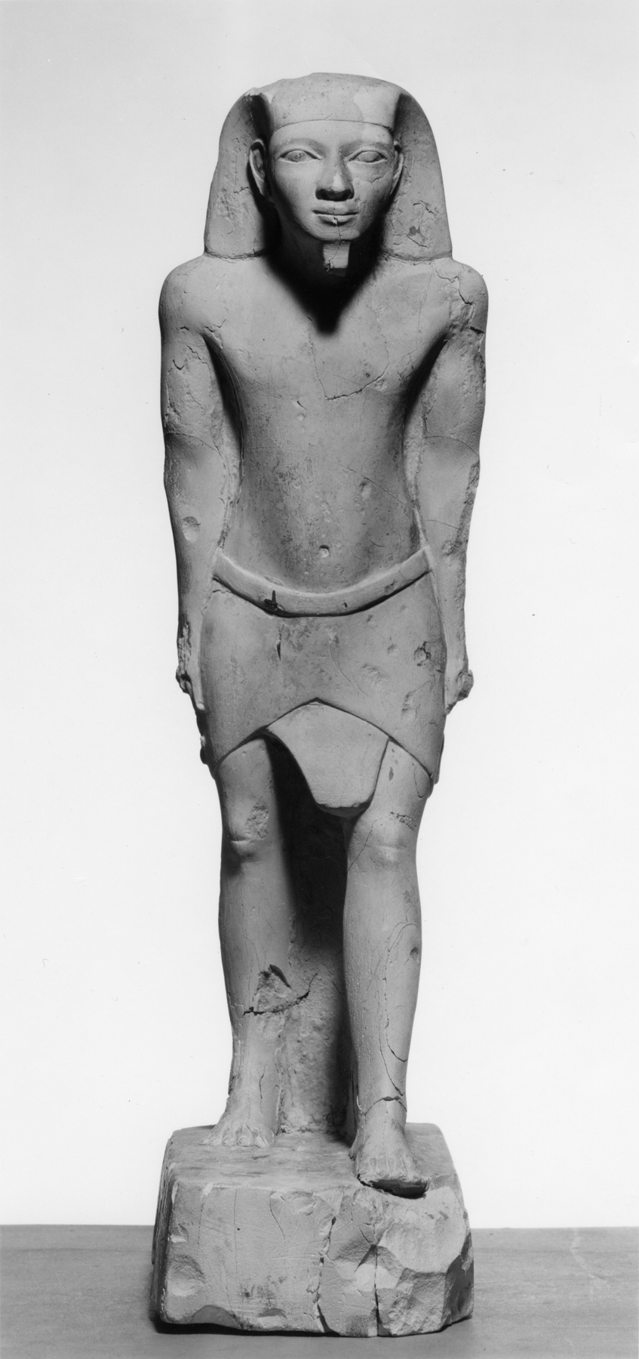
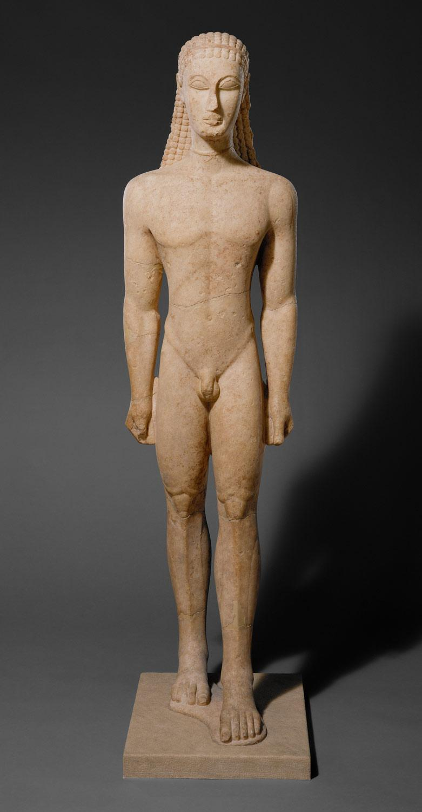
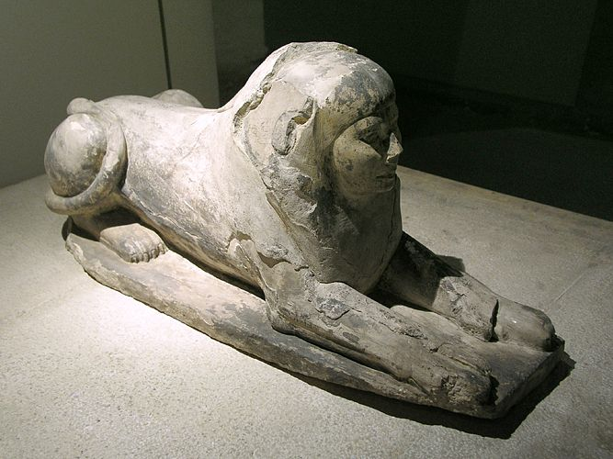
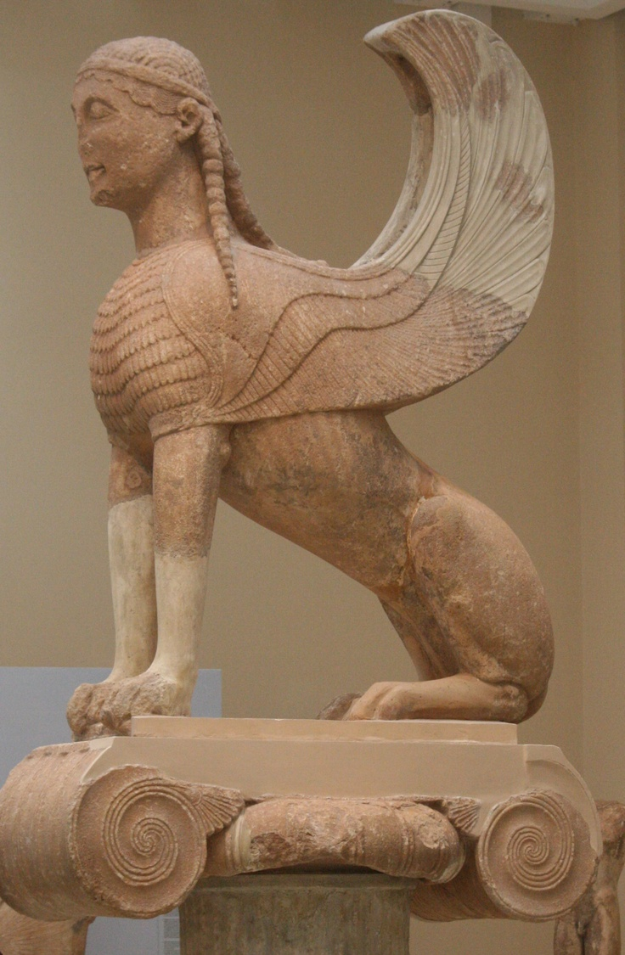
Notes:
Dunhaung MSS langs: Chinese, Khotanese, Sanskrit, Sogdian, Tangut, Tibetan, Old Uyghur language, Hebrew and Old Turkic
5th to early 11th
Shinx: Egyptian Sphinx_of_Hetepheres_II
https://upload.wikimedia.org/wikipedia/commons/7/7c/Egyptian_-_Male_Figure_Standing_-_Walters_22151.jpg
http://www.metmuseum.org/toah/images/hb/hb_32.11.1.jpg
https://s-media-cache-ak0.pinimg.com/736x/82/bf/e8/82bfe8ef007c5ef693a1266177a3e846.jpg
https://upload.wikimedia.org/wikipedia/commons/6/61/Sphinx_of_Hetepheres_II_-_fourth_dynasty_of_Egypt.jpg

Slide 10
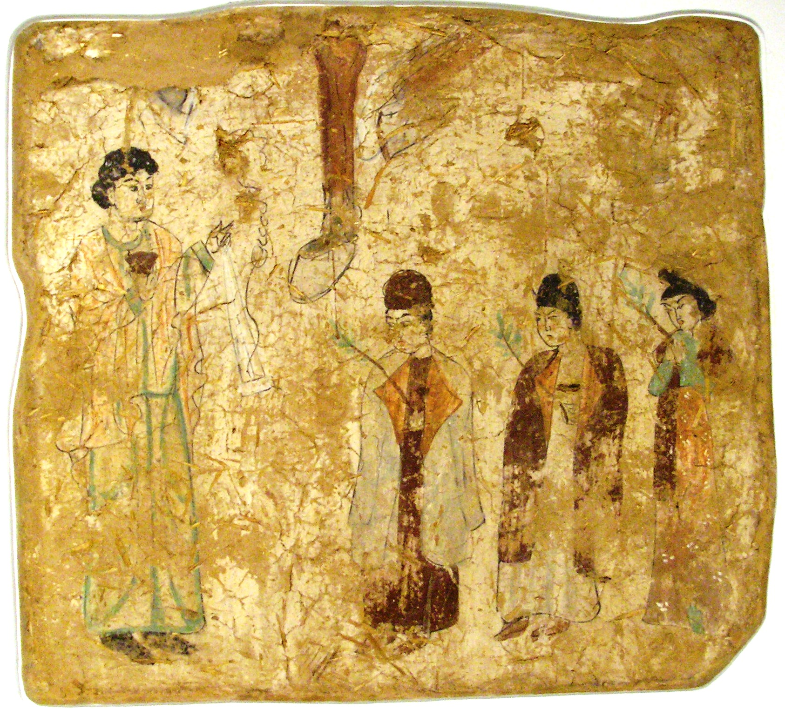
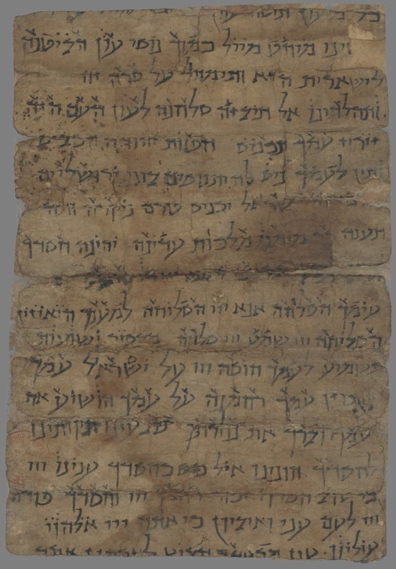
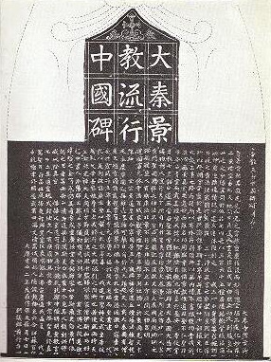
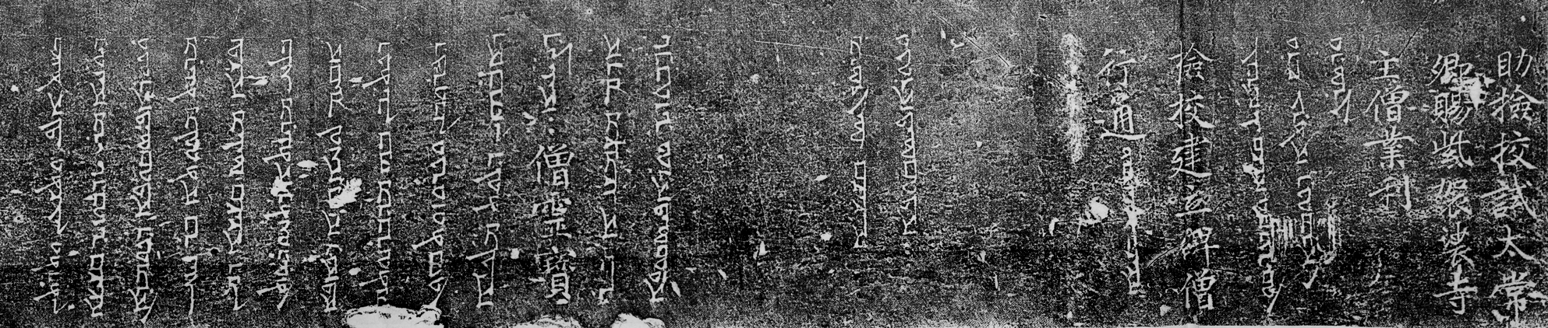
Notes:
Nestorian Stele (Syrian and Chinese), 781
Palm Friday painting
Hebrew text from Dunhuang (MSS incl Chinese, Khotanese, Sanskrit, Sogdian, Tangut, Tibetan, Old Uyghur language, and Old Turkic)
https://en.wikipedia.org/wiki/Nestorian_Stele

Slide 11
Literary parallels
East-to-west
Aesop's fable
Jesus walking on water motif
West-to-east
Milinda Panha
Translation of Aristotle (and many scientific Greek texts) to Arabic, then later back to Western languages
Notes:
supposedly 7-6th c bc - as old as pre-2000 bc (Sumerian and Akkadian) - the Buddhist Jataka tales - Hindu PanchatantraJesus, motif of walking on water attested widely in Indian lit
Milinda: Pali, 100 bc, of purported dialog w/ indo-greek Menander I of Bactria; discourse with Nagasena
https://en.wikipedia.org/wiki/Milinda_Panha

Slide 12
Notes:
These are clues to intercultural interchange. What can we do to help our isolated scholars reach out and learn from one another?

Slide 13
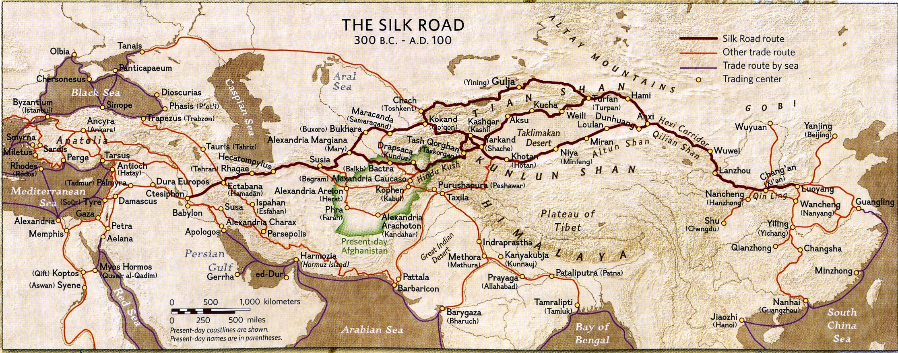

Slide 14
Philology & AI
Notes:
10 min

Slide 15
Philology
Basics
φιλολογία == philo + log[os] + ia == the love of words/reason
Textual criticism, paleography, historical linguistics
Decoded most foundational ancient knowledge by end of 19th century

Slide 16
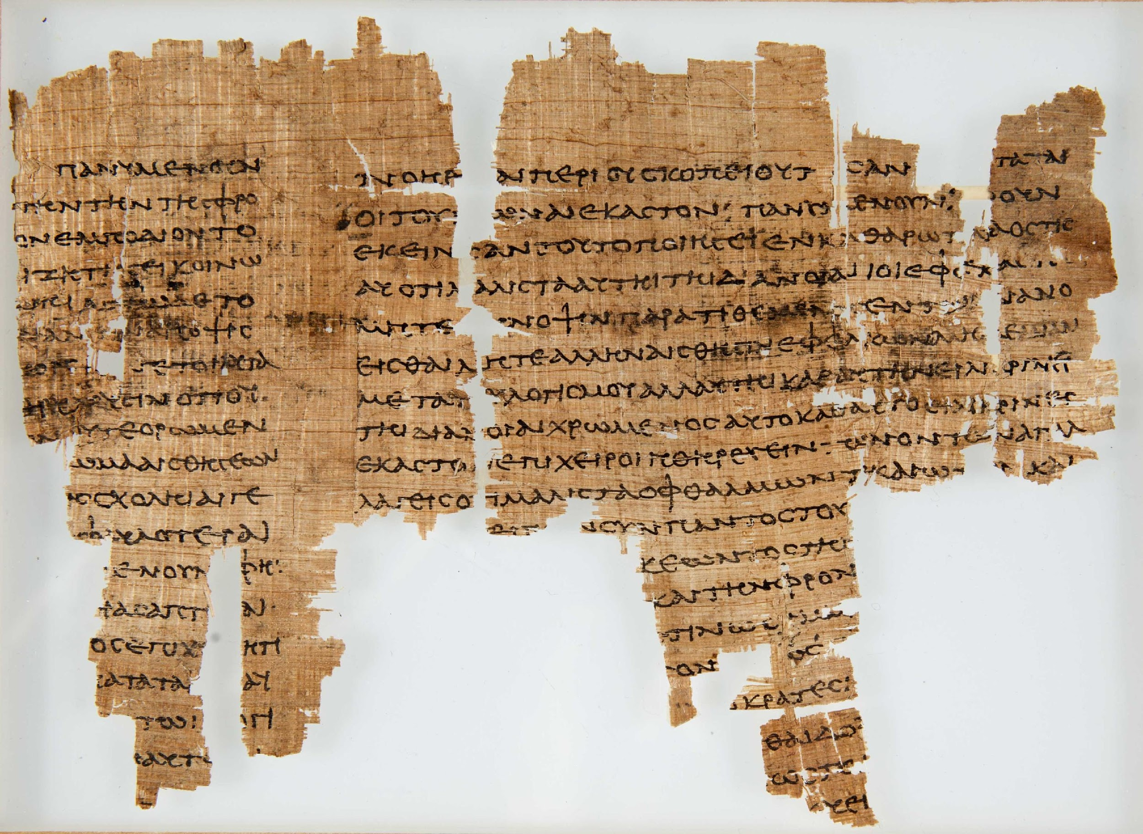
Notes:
http://www.hum.leiden.edu/papyrological-institute/papyrus-collection/exhibition-h.html

Slide 17
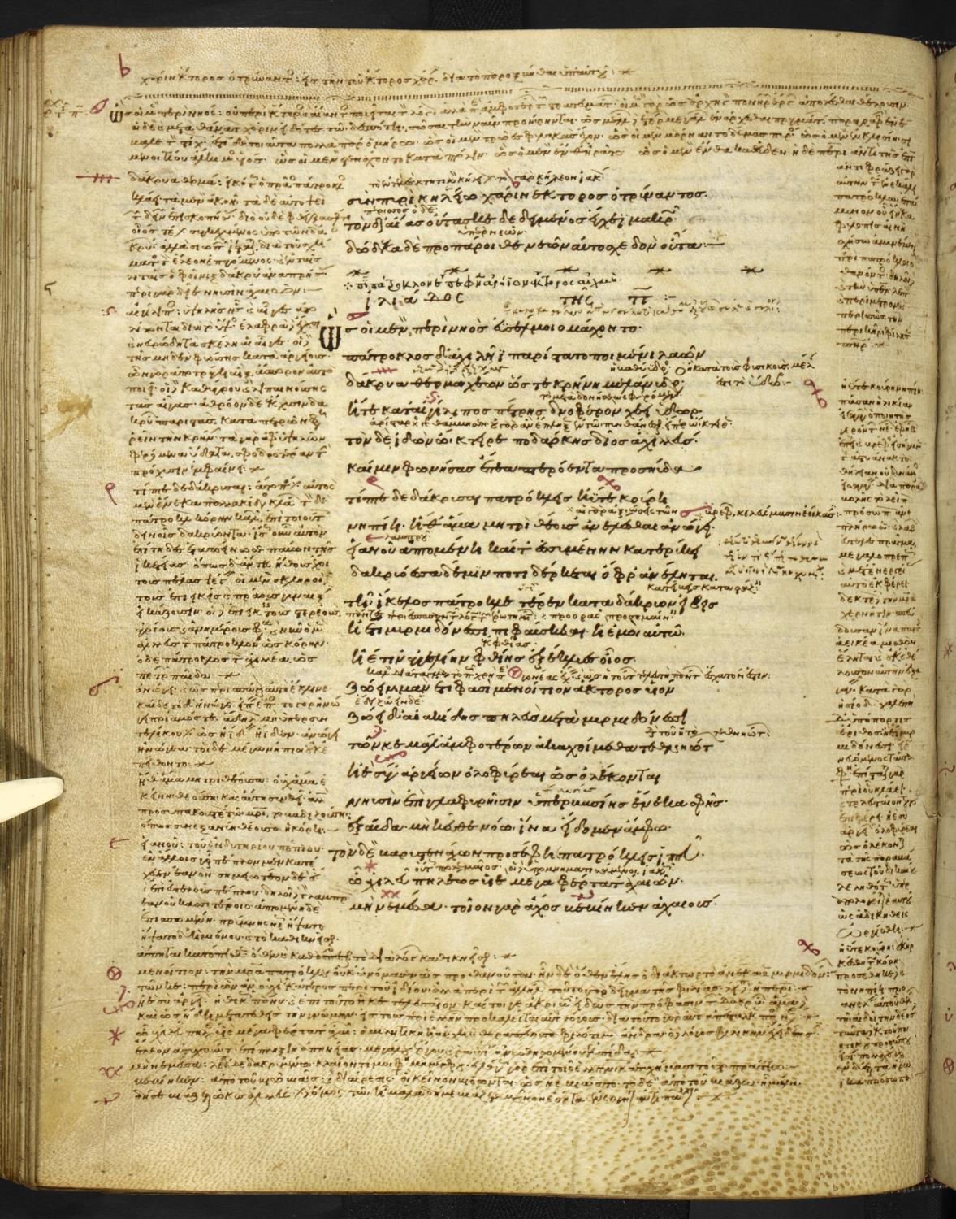
Notes:
http://blogs.bl.uk/digitisedmanuscripts/2013/08/hooray-for-homer.html

Slide 18
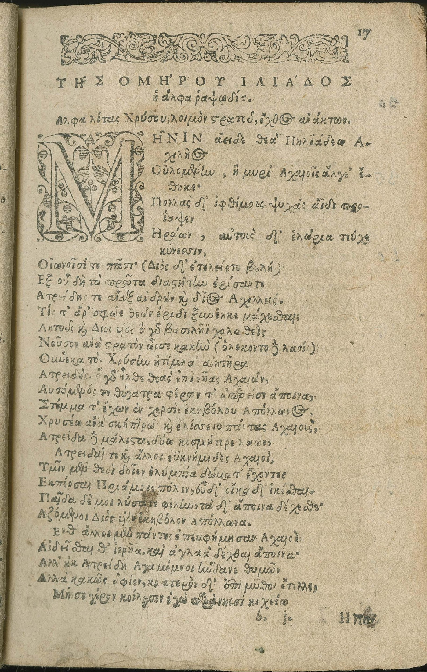
Notes:
https://www.lib.umich.edu/special-collections-library/book-soldier-and-professor-tale-flames-iliad

Slide 19
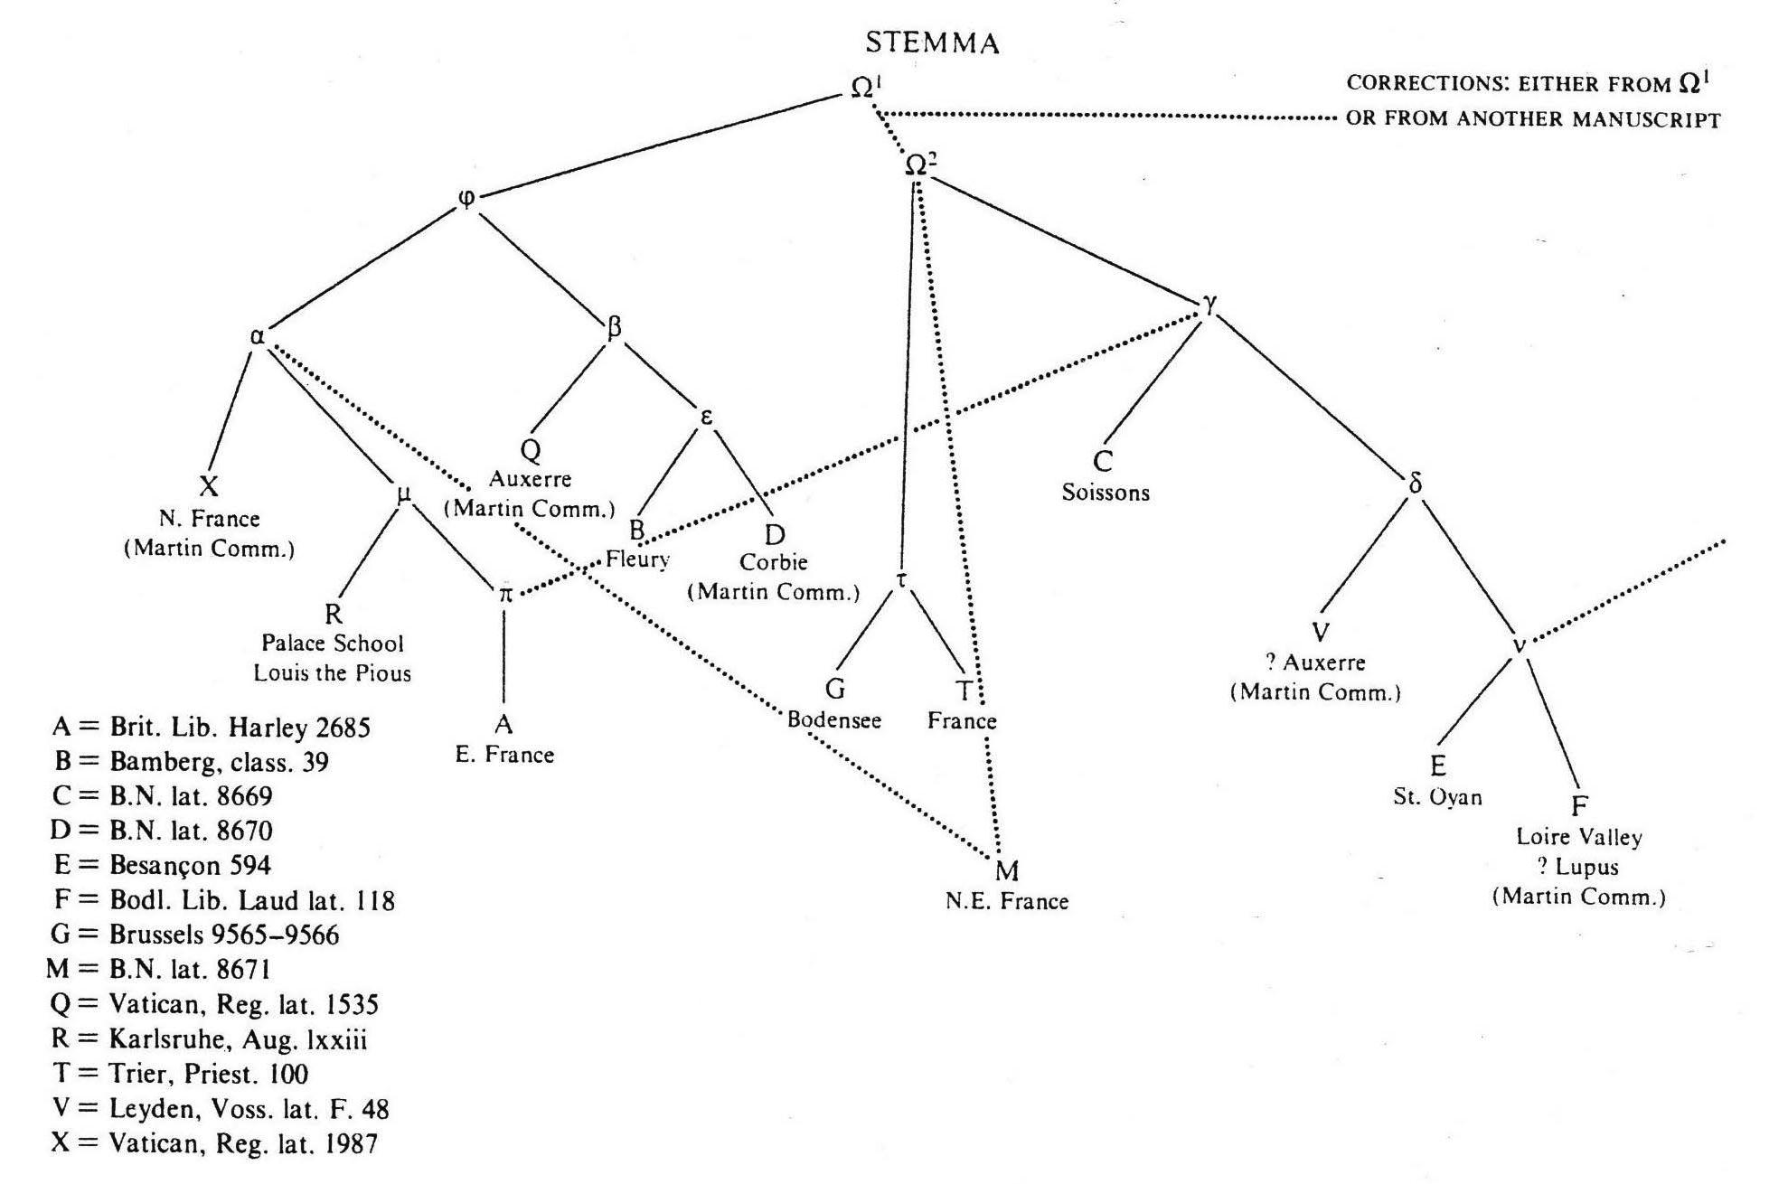
Notes:
https://wiki.hiit.fi/display/stemmatology/Stemma
“Stemma for De nuptiis Philologiae et Mercurii by Martianus Capella proposed by Danuta Shanzer (1986, p. 62-81). Hyparchetypes are shown in lower case Greek letters, extant manuscripts in upper case Latin ones. Dotted lines represent contamination. Ω represents the archetype which suffered corrections (possibly extra-stemmatic) after having been copied."

Slide 20
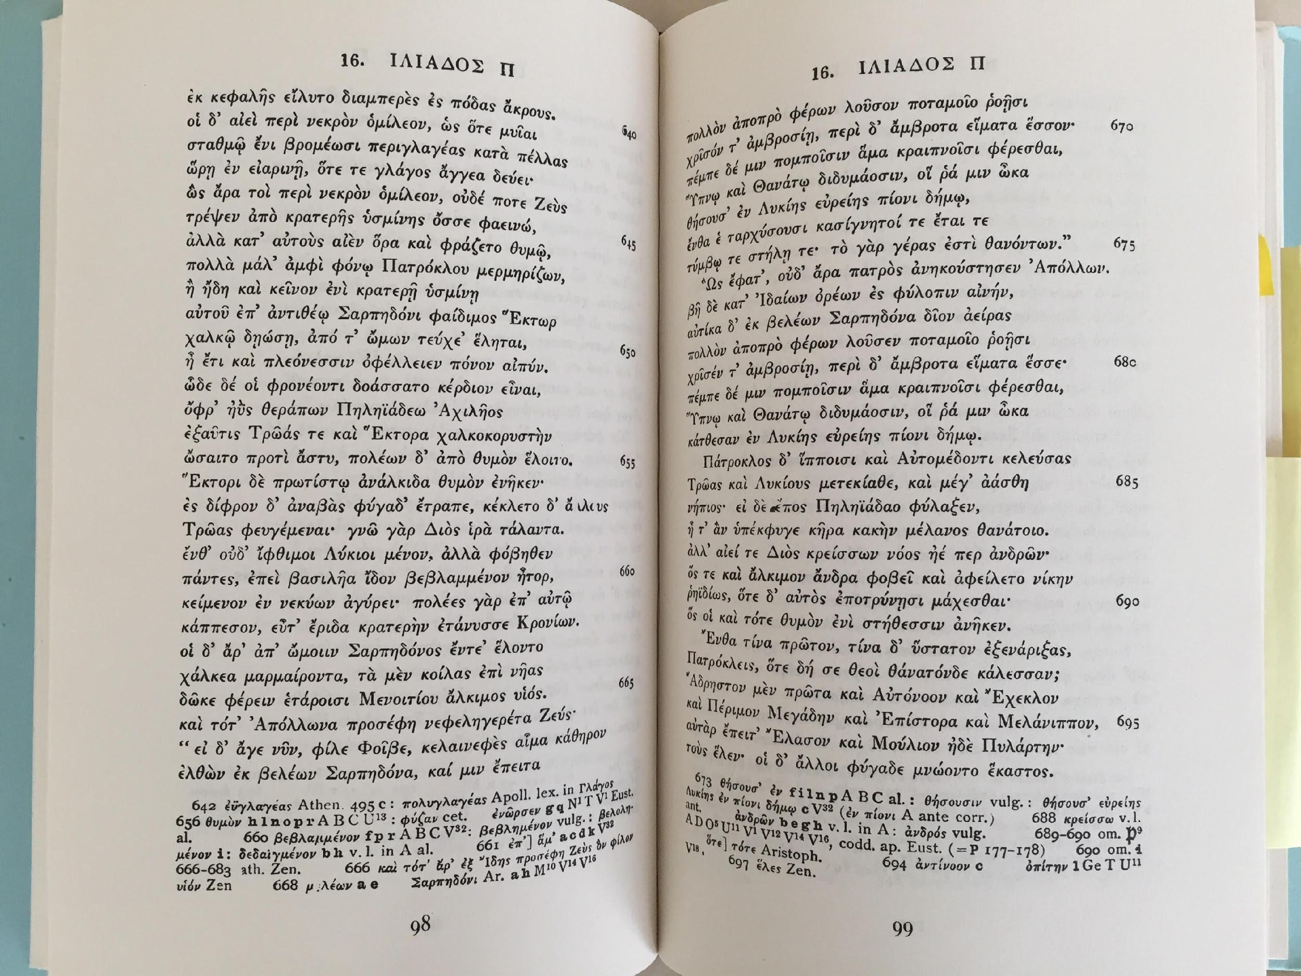

Slide 21
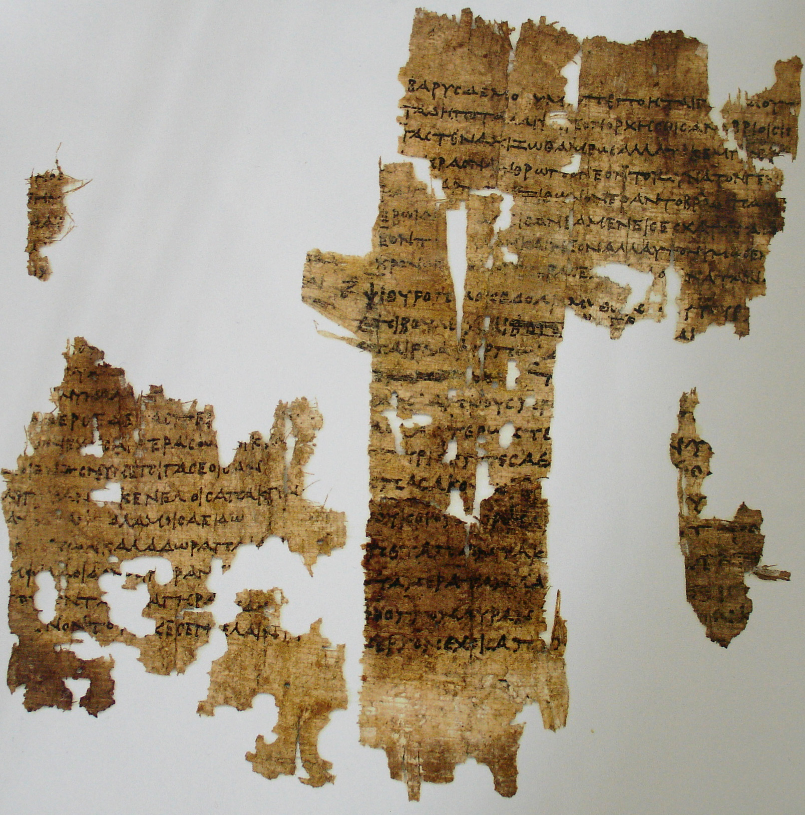
Notes:
new Sappho
https://upload.wikimedia.org/wikipedia/commons/8/8b/P.K%C3%B6ln_XI_429.jpg

Slide 22
Philology
Basics
φιλολογία == philo + log[os] + ia == the love of words/reason
Textual criticism, paleography, historical linguistics
Decoded most foundational ancient knowledge by end of 19th century
Famous philologists
Friedrich Nietzsche
J. R. R. Tolkien
Notes:
Nietzsche: "Classicists:
* are windbags and triflers
* are repulsive
* stutter
* are filthy pedants
* are hair splitters and screech-owls
* are incapable of symbolism
* are passionate slaves of the State
* are twisted Christians
* are philistines"
Tolkien: made Elvish based on research into Welsh and Finnish
Other Classicists: Karl Marx, Max Weber

Slide 23
Philology
Methodology
Determine historic influence
Define author and genre stylistics
Formalistic and (extremely) descriptive grammar
Comparison to similar language families and literatures

Slide 24
Philology: Basics
Methodology
Determine historic influence
Define author and genre stylistics
Formalistic and (extremely) descriptive grammar
Comparison to similar language families and literatures
vs. linguistics
Written language primary
Diachronic
Comparative
Focus on highly complex linguistic utterances (i.e., literature and philosophy)

Slide 25
Philology vs. Endangered languages
Similarities
Few speakers
Few experts
Linguistic in nature

Slide 26
Philology vs. Endangered languages
Similarities
Few speakers
Few experts
Linguistic in nature
Differences
Less urgency
Fixed corpus
Limited cultural context
Expensive experts
No native speakers

Slide 27
Philology & AI?
Augmented reading
Allusion discovery
Historical trends
Statistical attributes of texts and authors
Notes:
Give stat on how much Galen untranslated; Give idea of how much Sanskrit survives – most not translated into a modern language; Chinese, arabic, list goes on …

Slide 28
Philology & AI?
Augmented reading
Allusion discovery
Historical trends
Statistical attributes of texts and authors
Augmented scholarship
Machine translation
Inter–language mappings
Tailored language tutors
Bot research assistants
NLG research papers
Notes:
Give stat on how much Galen untranslated; Give idea of how much Sanskrit survives – most not translated into a modern language; Chinese, arabic, list goes on …

Slide 29
Classical Language Toolkit
Notes:
20 min

Slide 30
CLTK: Basics
Goals
NLP for all dead languages
Quantified philology & literature scholarship
Interdisciplinary philology
Notes:
* First step is to introduce NLP to classical studies;
* Second to rationalize literary studies, which have largely abandoned its philological roots
* Third to help interdisciplinary work

Slide 31
CLTK: Basics
Goals
NLP for all dead languages
Quantified philology & literature scholarship
Interdisciplinary philology
Scope
Archaic, Ancient, Classical, Medieval & pre–Modern Eurasia (and parts of N Africa, too)
Any civilization with surviving written texts
Printing press is the cutoff

Slide 32
CLTK: Basics
Software
Python language, based on NLTK; distributed on PyPI
Simplified code base
Good docs and tutorials
Guidelines for important non–CLTK projects

Slide 33
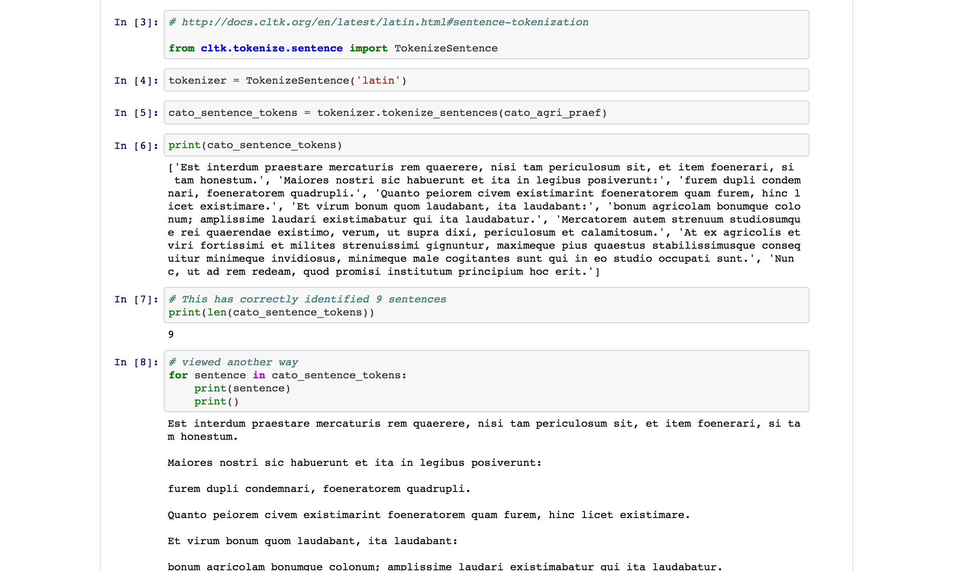
Notes:
Sentence tokenization

Slide 34
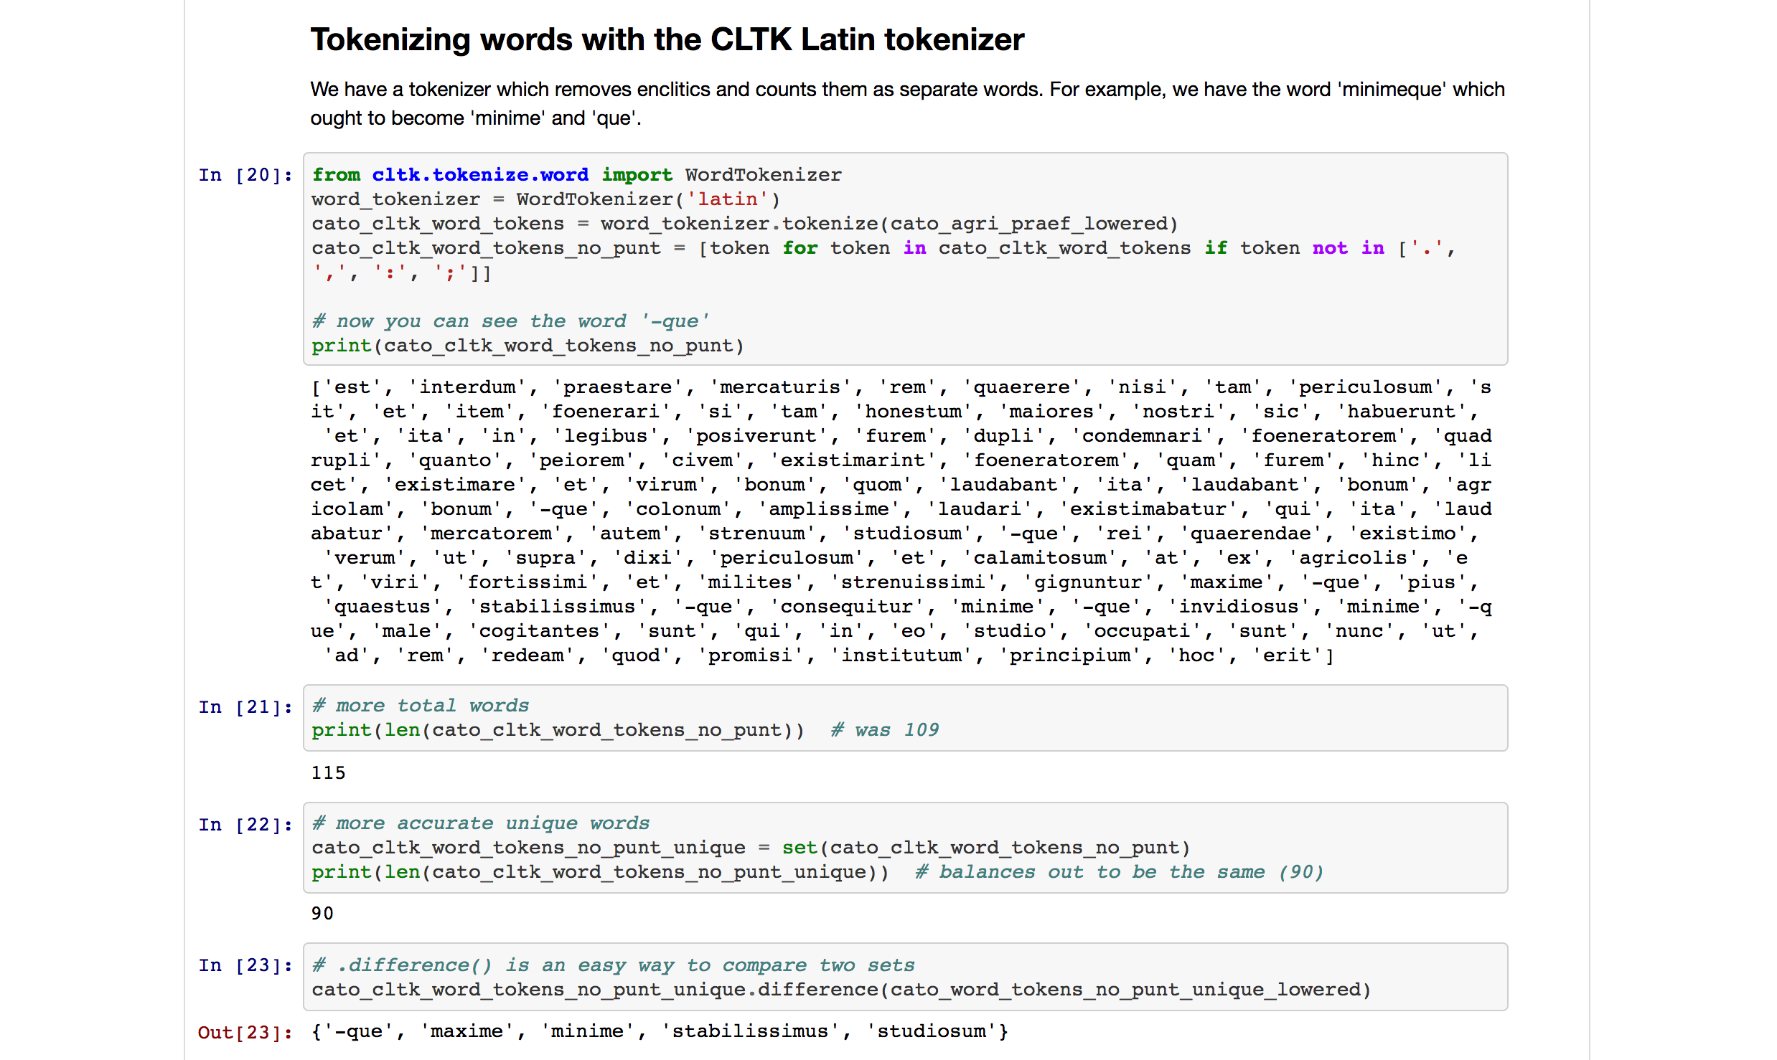
Notes:
tokenize words

Slide 35
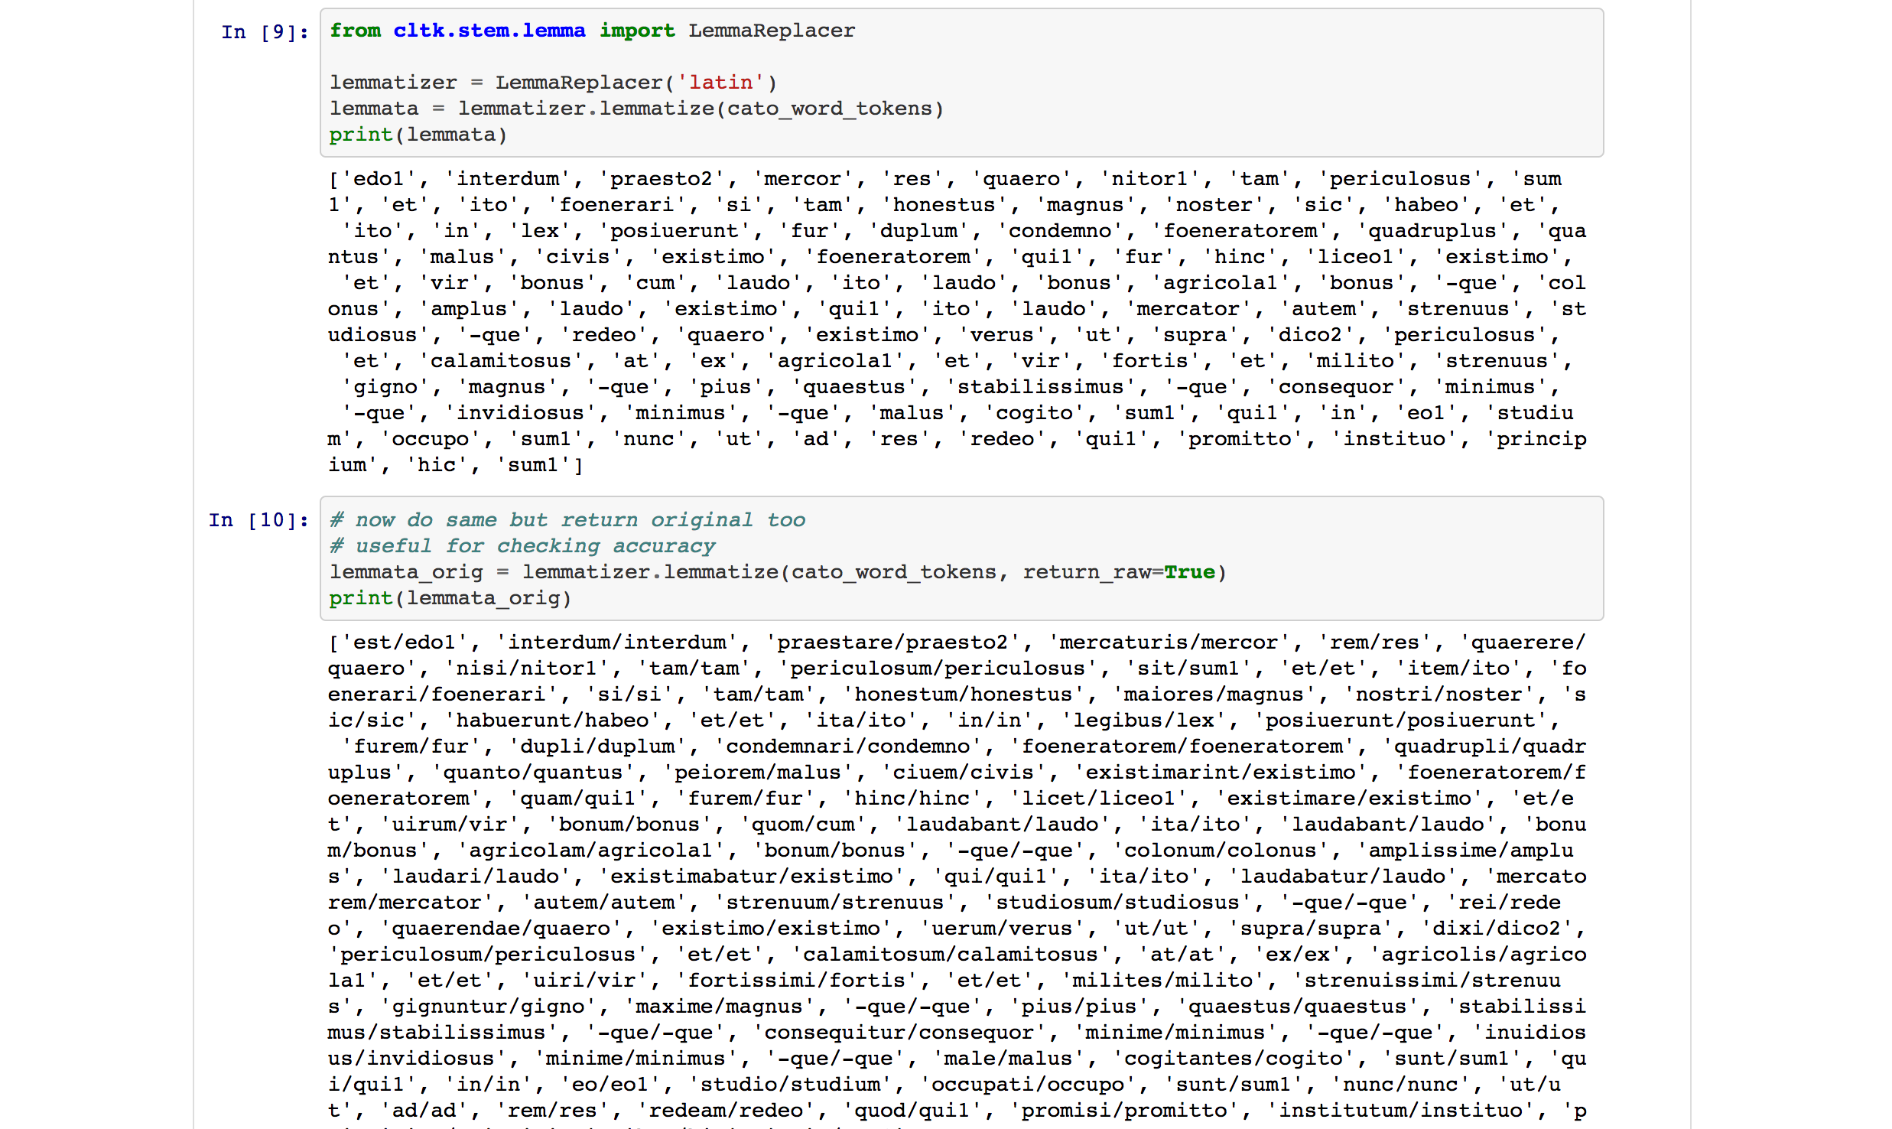

Slide 36
CLTK: Basics
Software
Python language, based on NLTK; distributed on PyPI
Simplified code base
Good docs and tutorials
Guidelines for important non–CLTK projects
Stats
22 languages
231 stars, 158 forks, 50 watchers
49 contributors
33 releases
78 linguistic repos

Slide 37
CLTK: Architecture
Architecture
Extensible
Common API for all languages
Git–based distribution of data sets
Data sets version controlled

Slide 38
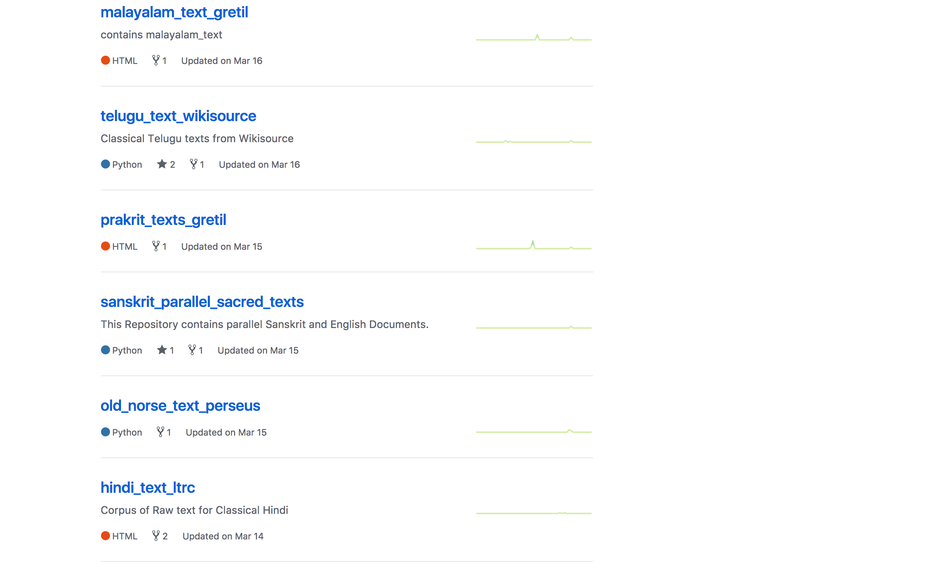
Notes:
Give screenshot of GitHub homepage

Slide 39
CLTK: Git data distribution

Slide 40
CLTK: Git data distribution

Slide 41
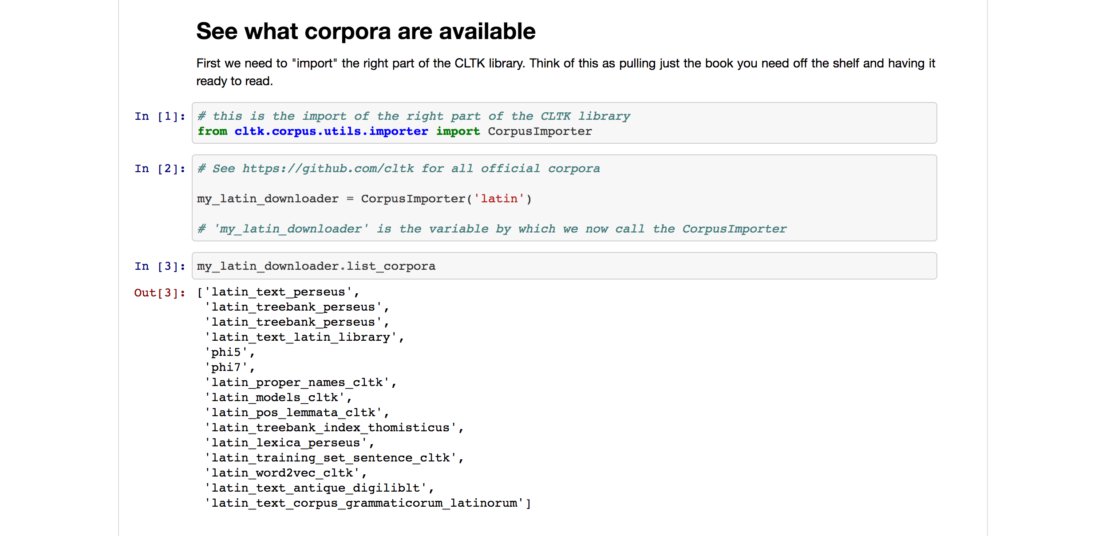

Slide 42
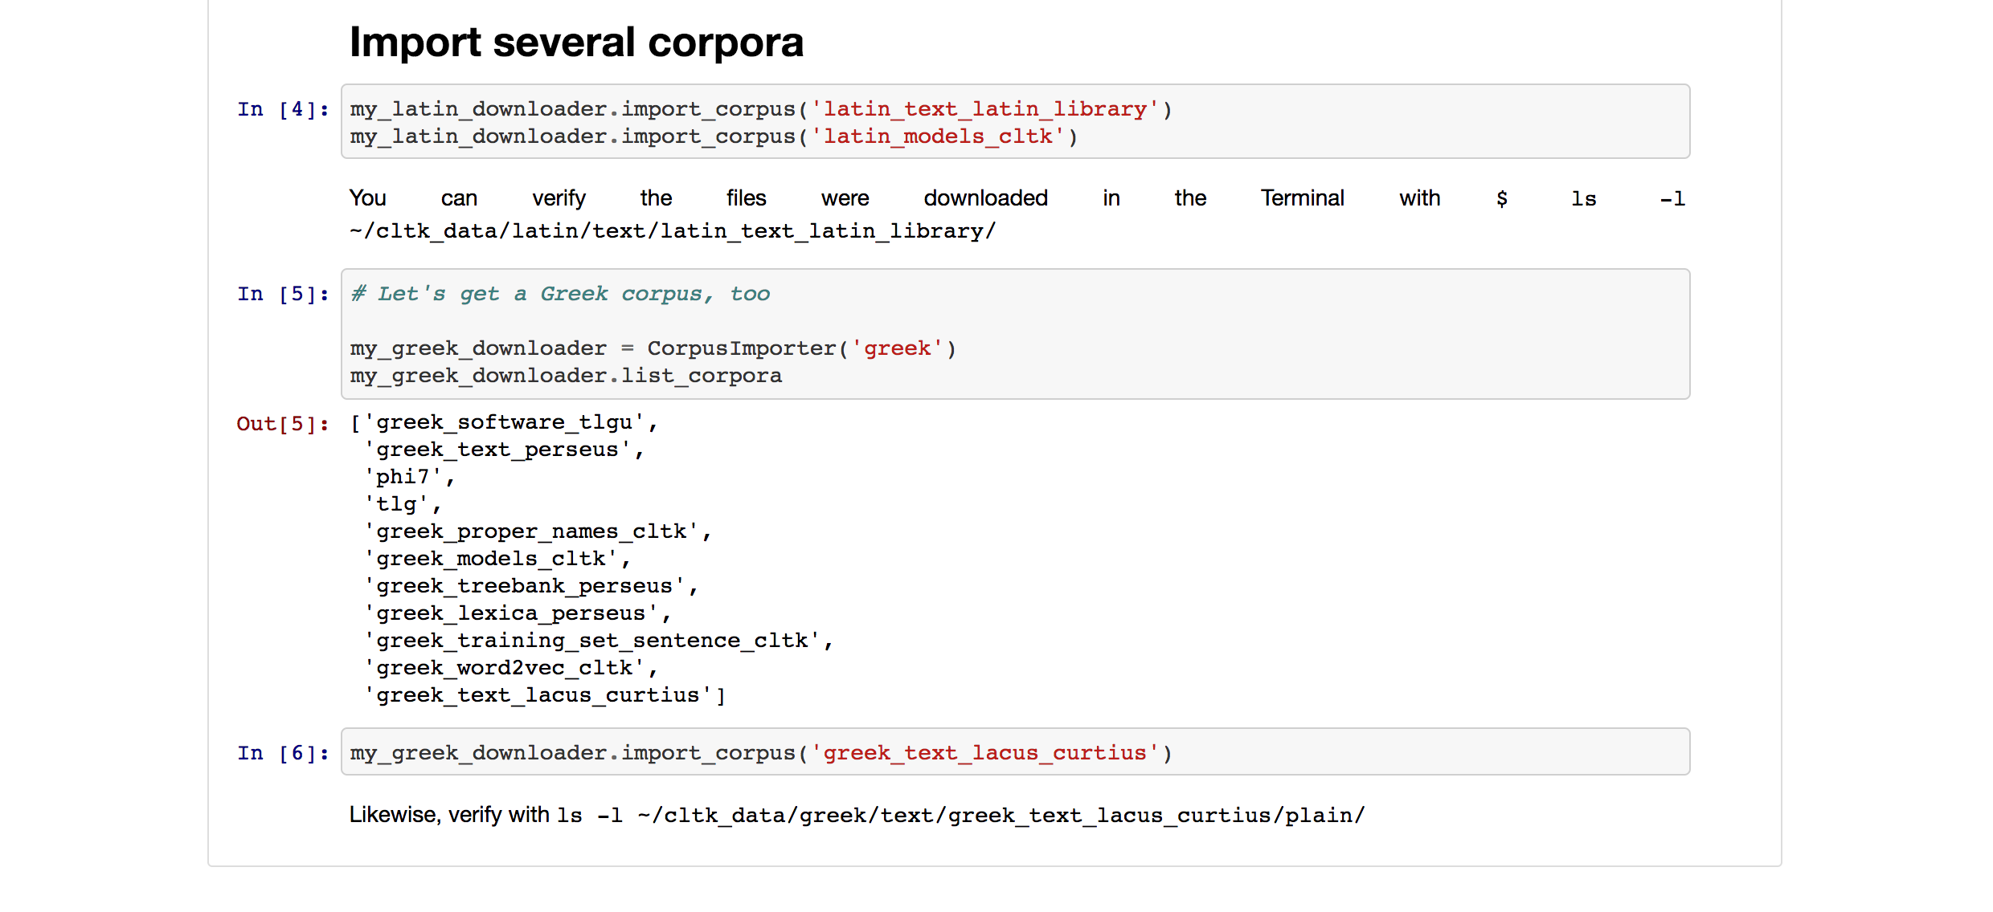

Slide 43
CLTK: Architecture
Architecture
Extensible
Common API for all languages
Git–based distribution of data sets
Data sets version controlled
Process
Open development on GitHub
MIT license

Slide 44
Growing academic attention; Board of Advisors created
Second Google Summer of Code, website launch
Start Latin Language Toolkit
Fall 2012
Winter 2014
2015–16
Summer 2016
Summer 2017
Refactor for Greek and Latin, others; becomes Classical Language Toolkit
First Google Summer of Code, website beta

Slide 45
Design principles (code & data)
Extensibility Accepting of any proven NLP algorithms; 100% NLP coverage of all ancient languages
Simplicity Not only API but source is kept clean and simple as possible; intentionally un–clever
Standardization Scientific reproducibility; Good basic texts, but editable
Disintermediation Independent of academic bureaucracy; Software direct into researchers’ hands
Decentralization Distributed by Git; Not “pet project” of one person, but of many

Slide 46
Design principles (community)
Transparency Public development on GitHub; Public, readable code
Multi–disciplinary Academic departments, CS, faith traditions; Intersection of industry & academe
Mutual benefit Full public record of all commits; Researchers develop own work
Inclusion Collaborative, encouraging; Free, easy communication
Free & open source Fork, modify, merge … whatever!; MIT license (OK for commercial use)
Notes:
Give that dismal hortensii stat on 90% of Classicists on public assistance; compare that to some other pathetic groups for laughs

Slide 47
Partnerships
Institutions
Perseus Project (Tufts)
Open Philology (U Leipzig)
Center for Hellenic Studies (Harvard)
Google Summer of Code
Students
Mentor CS students in NLP
Mentor language students in coding
Support scholarship
Help post–graduation career transition
Notes:
Give that dismal hortensii stat on 90% of Classicists on public assistance; compare that to some other pathetic groups for laughs

Slide 48
CLTK online
API
http://api.cltk.org
Serve texts, do NLP
RESTful design
Python w/ the Flask framework
Docker containers, served on GCP
Notes:
Give that dismal hortensii stat on 90% of Classicists on public assistance; compare that to some other pathetic groups for laughs

Slide 49
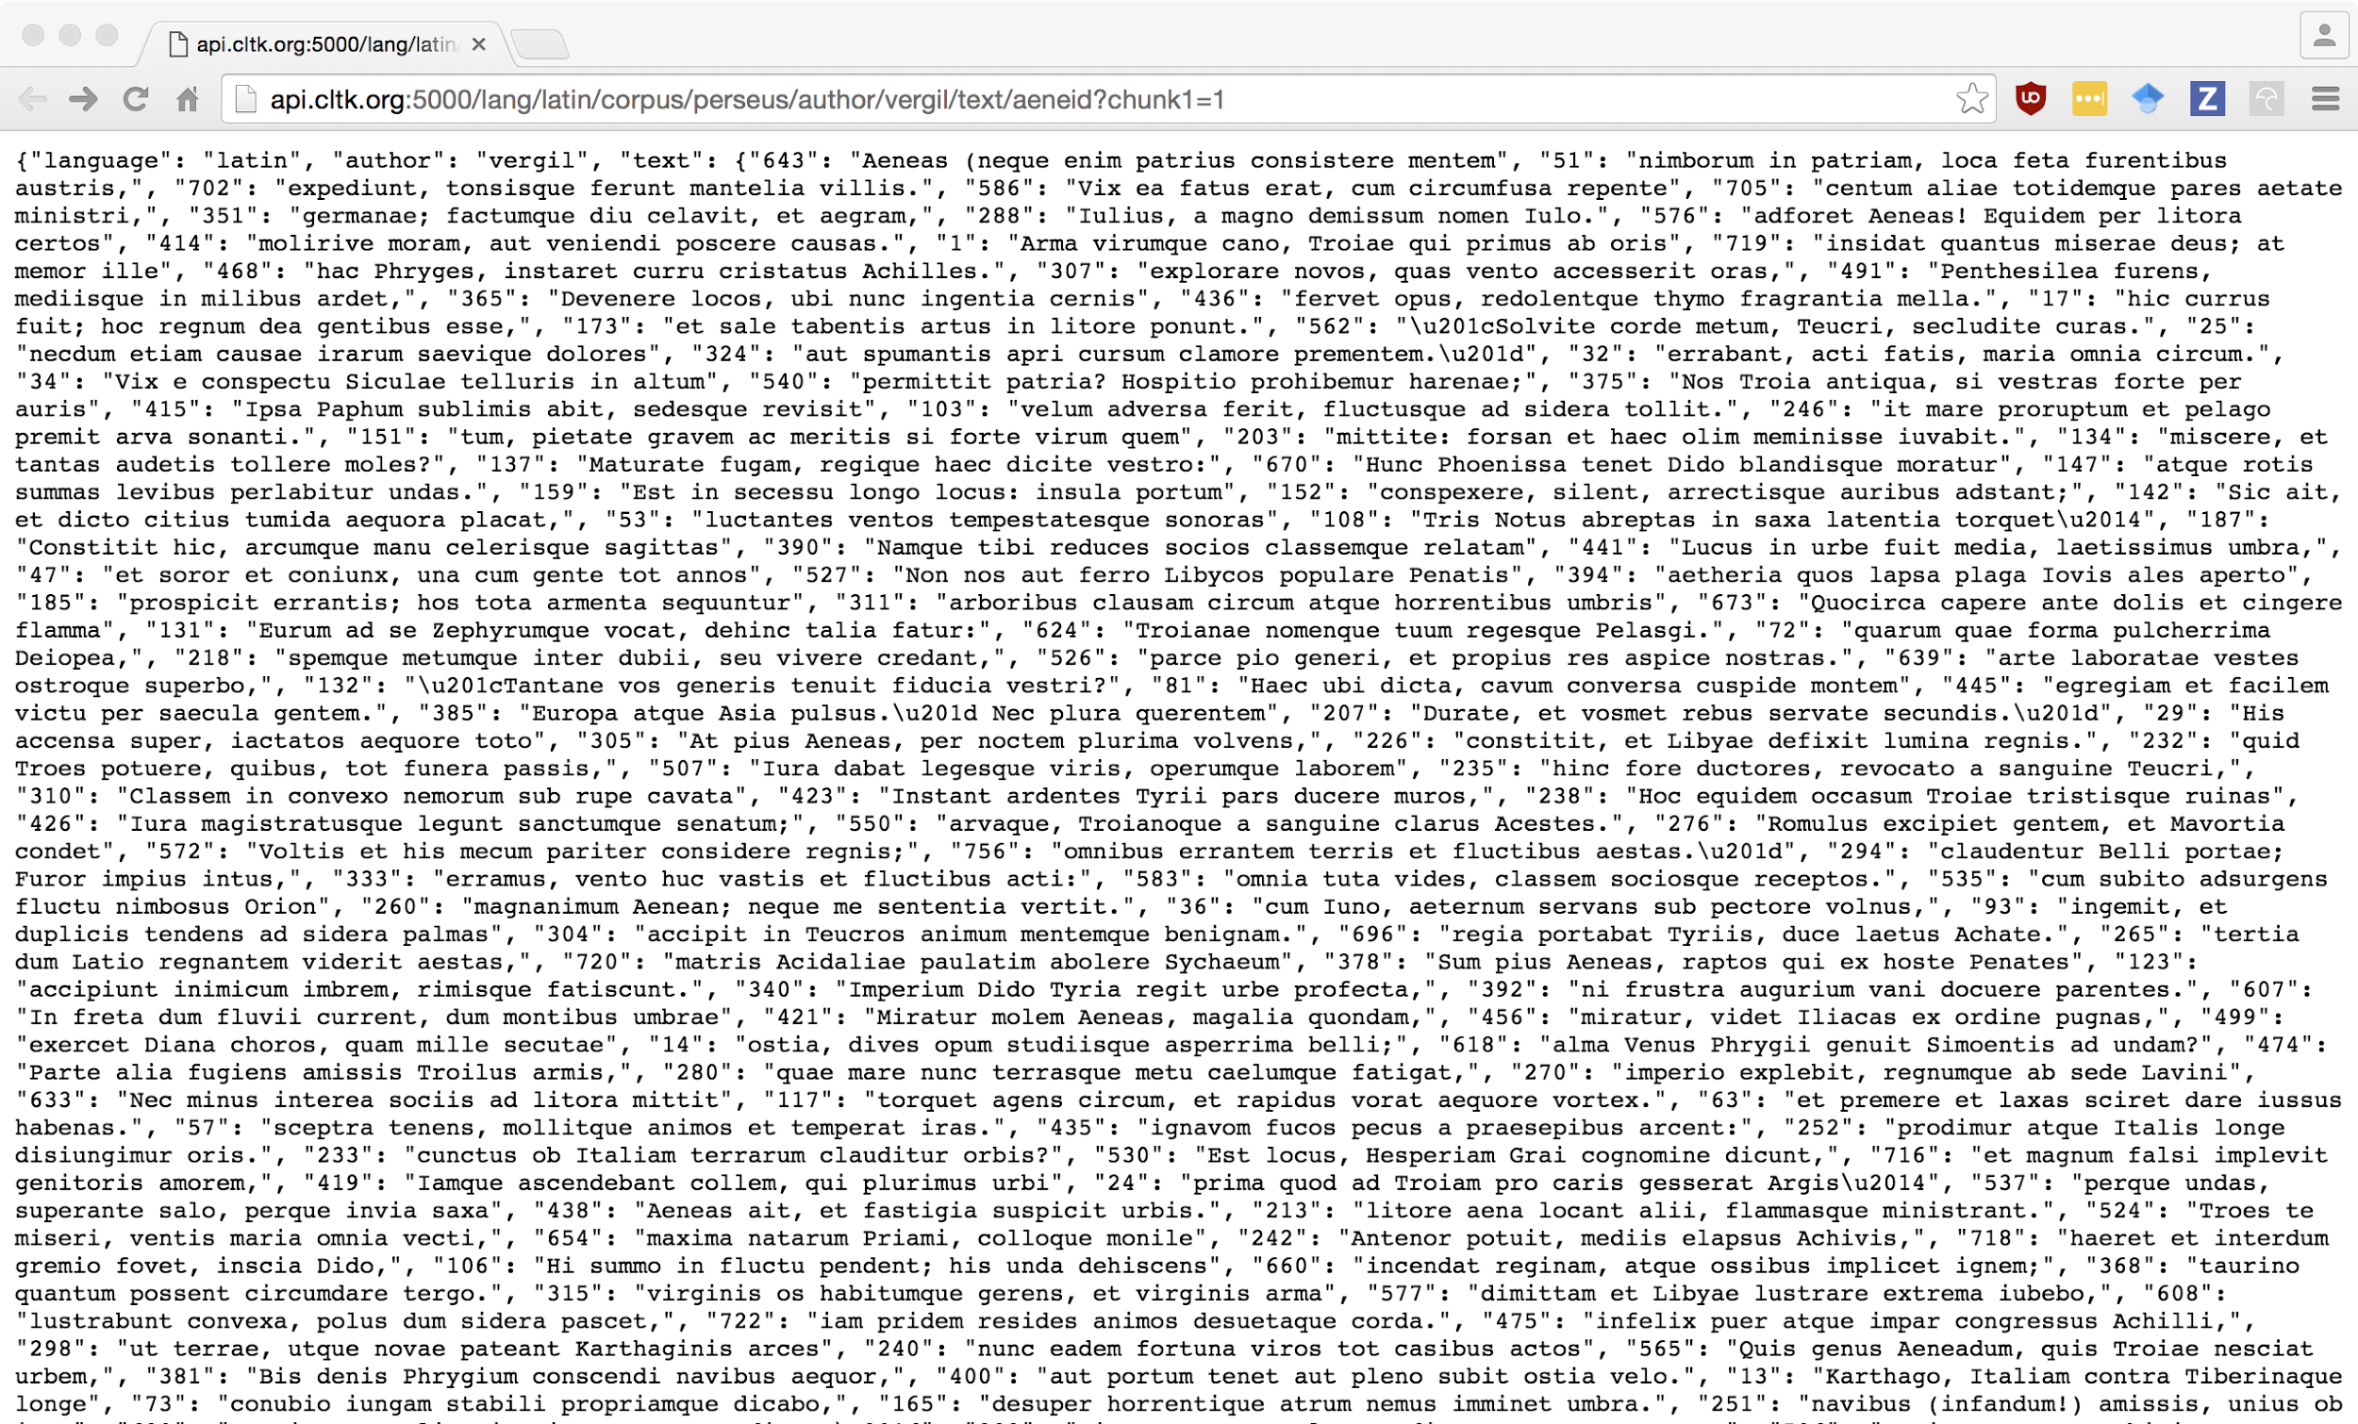

Slide 50
CLTK online
API
http://api.cltk.org
Serve texts, do NLP
RESTful design
Python w/ the Flask framework
Docker containers, served on GCP
Archive
Reading and research environment
611 classical texts, 109 authors
5 languages
4,593 definitions for 14,489 word forms
Notes:
Give that dismal hortensii stat on 90% of Classicists on public assistance; compare that to some other pathetic groups for laughs

Slide 51
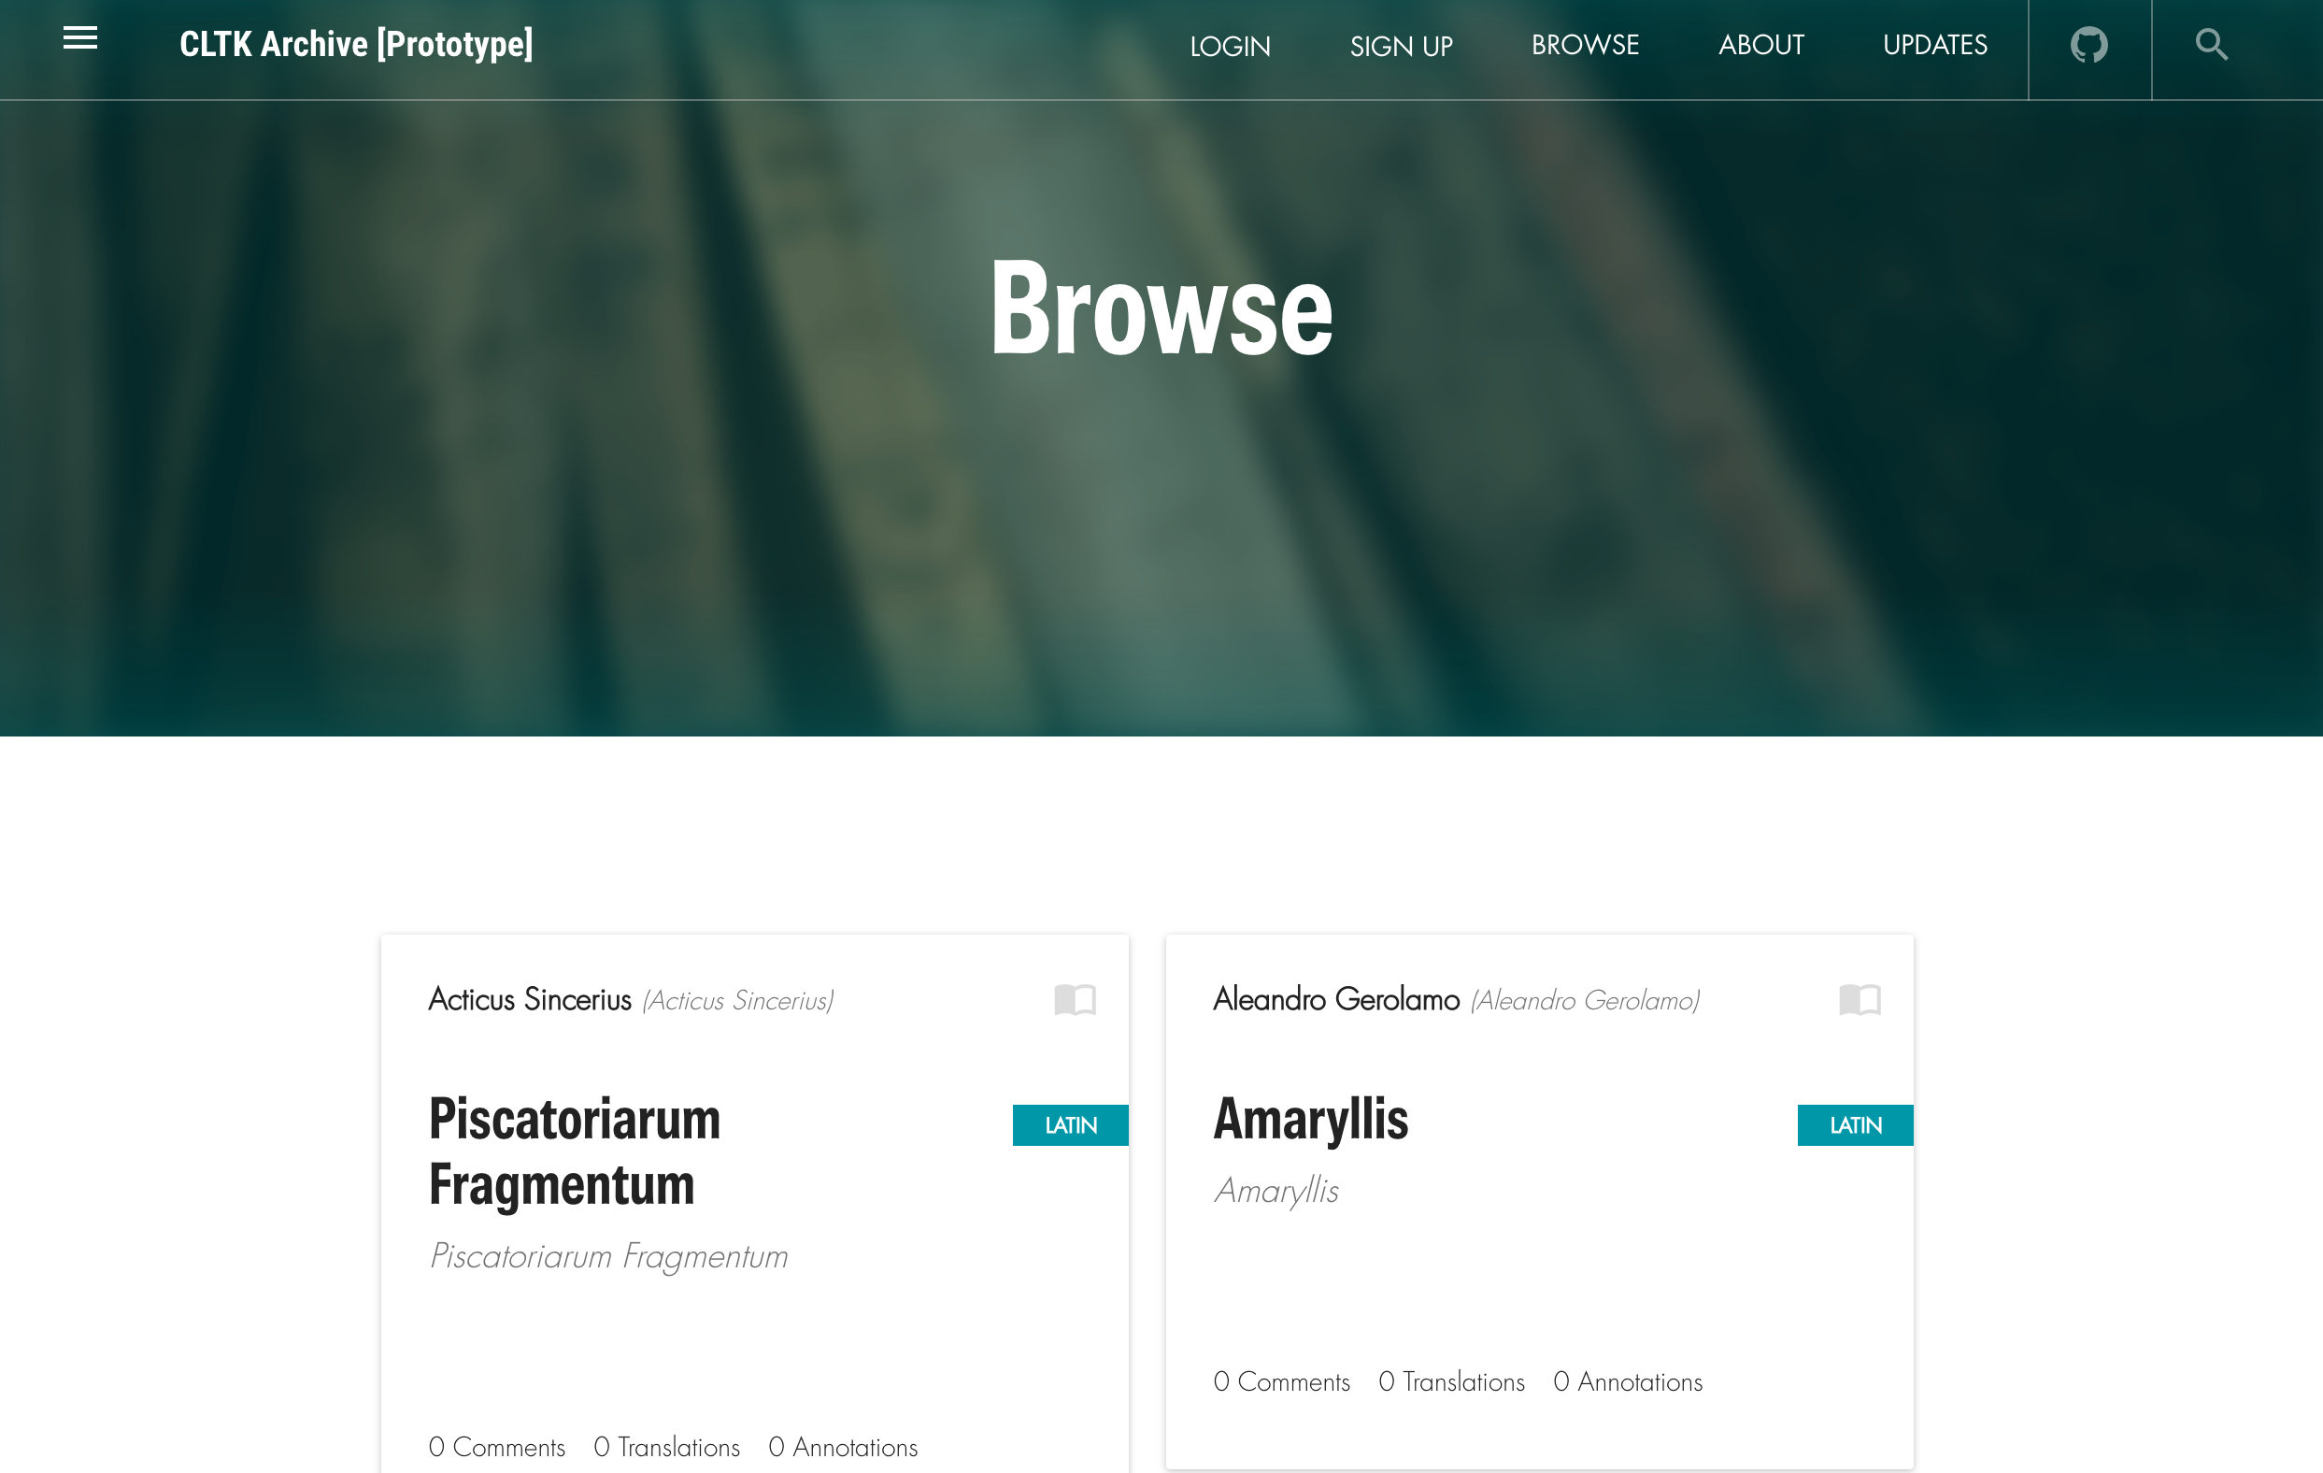

Slide 52
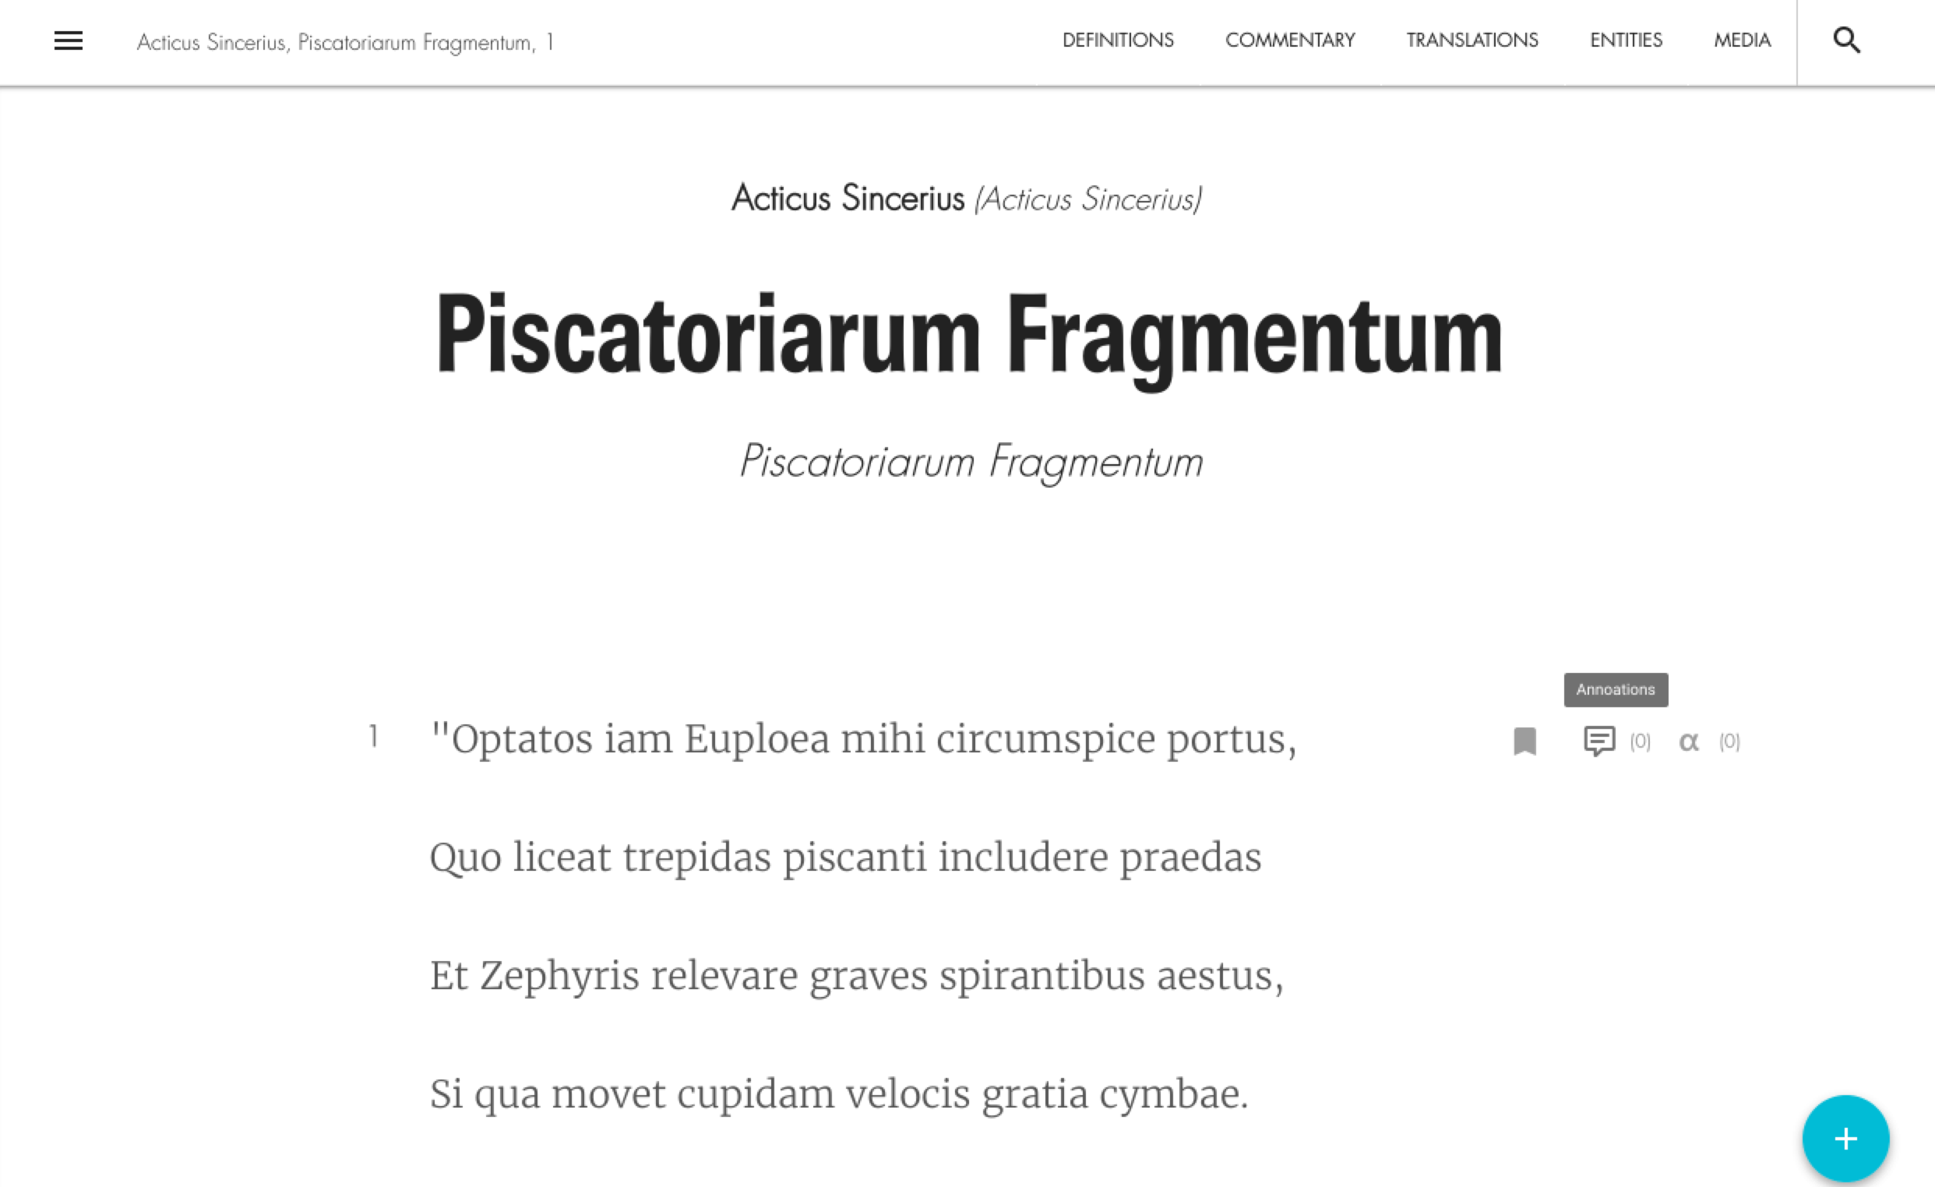
Notes:
Add archive screenshots

Slide 53
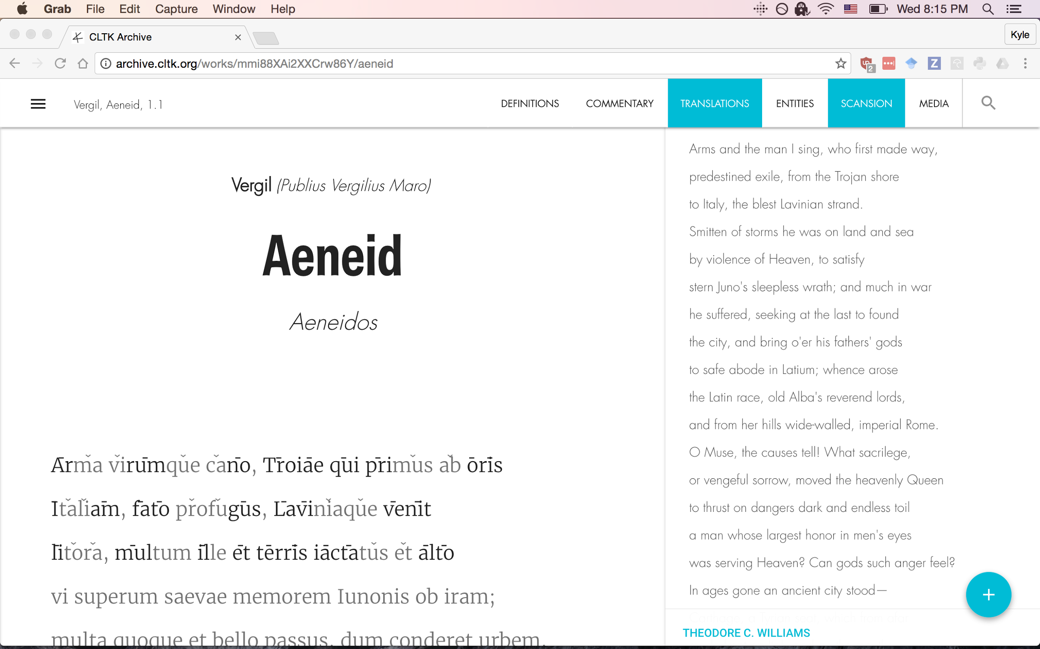

Slide 54
Research examples

Slide 55
Problem
Quantitative modeling of the properties associated with hard–to–read Latin. Introduces a Latin version of the Automated Readability Index, to help teachers find text suited to students’ “grade level”. (from Patrick J. Burns)
What is difficult Latin?
Notes:
https://diyclassics.github.io/virgils-hardest-sentence/

Slide 56
Problem
Analyze the prose rhythms of all of Cicero’s works and create a rhythmic profile representing his style. Compare that profile to Pliny’s letters and see which ones are particularly similar. Are certain books of letters more Ciceronian than others or is there a lot of consistency in Pliny’s rhythm usage? (from Tyler Kirby)
Are certain letters of Pliny more ‘Ciceronian’ than others?

Slide 57
Problem
Genre labels to Greek literature have slowly accumulated over the past 2,500+ years. Can we create statistical models which support what the tradition has created? Can culture–independent algorithms discover better text clusters? (from Kyle Johnson)
Are genre definitions more grounded in text or culture?

Slide 58
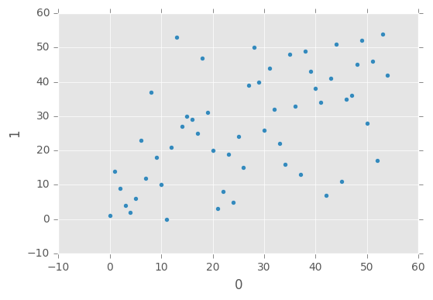
Epithet | precision | recall | f1-score | support
Alchemistae | 1 | 0.14 | 0.25 | 7
Comici | 0.68 | 0.51 | 0.58 | 51
Elegiaci | 0 | 0 | 0 | 8
Epici/-ae | 0.29 | 0.11 | 0.15 | 19
Grammatici | 0.4 | 0.2 | 0.27 | 20
Historici/-ae | 0.66 | 0.75 | 0.7 | 84
Lyrici/-ae | 0.29 | 0.17 | 0.21 | 12
Medici | 0.15 | 0.29 | 0.2 | 7
Philosophici/-ae | 0.45 | 0.48 | 0.46 | 46
Poetae | 0 | 0 | 0 | 7
Rhetorici | 0.38 | 0.25 | 0.3 | 12
Scriptores Ecclesiastici | 0.44 | 0.31 | 0.36 | 13
Sophistae | 0.33 | 0.25 | 0.29 | 8
Theologici | 0.25 | 0.4 | 0.31 | 5
Tragici | 0.15 | 0.6 | 0.24 | 15
avg / total | 0.49 | 0.45 | 0.45 | 314
Notes:
DT regression and clustering

Slide 59
Problem
Taking inspiration from bioinformatics, can we discover the growth of Greek and Latin literature over the centuries? How may we fashion a “tree of life” for the earliest Greek writings through the Byzantine era? (from Kyle Johnson)
Map the evolution of literature?
Notes:
is bioinformatics the correct discipline?

Slide 60
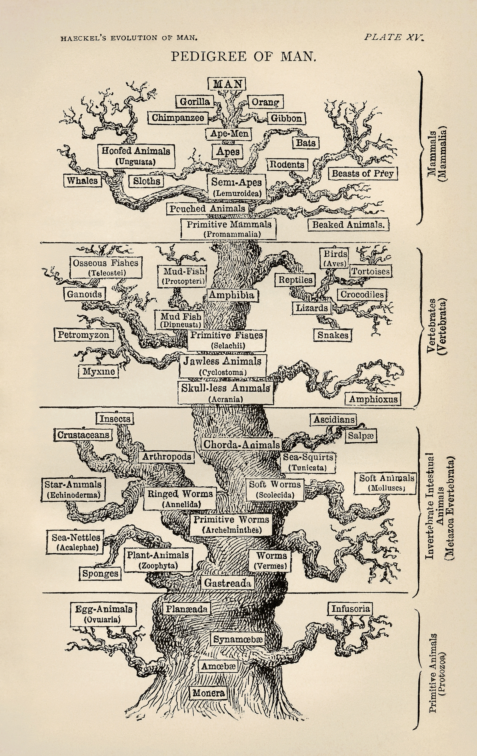
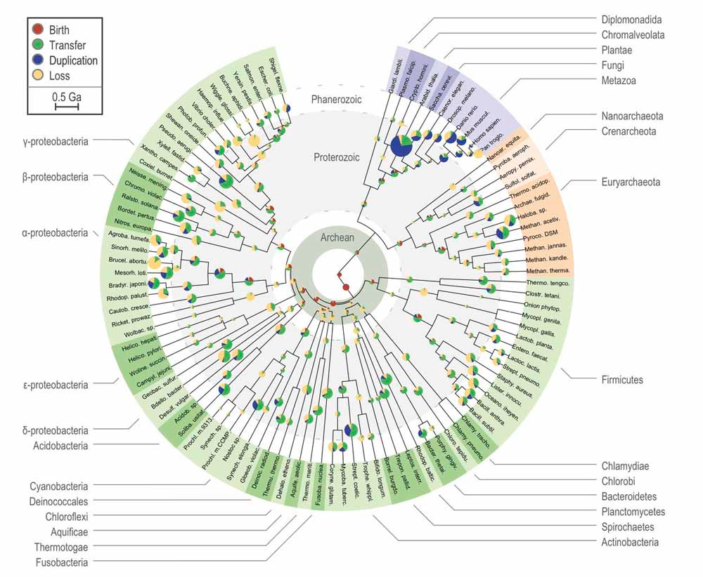
Notes:
Analogy, what are the different types of trees? It’s as if we used Linneaus’s categories, even though DNA sequencing tells us otherwise.
Ernst Haeckel: https://upload.wikimedia.org/wikipedia/commons/d/de/Tree_of_life_by_Haeckel.jpg
http://www.gridgit.com/postpic/2015/04/tree-life-evolution-chart_290093.jpg

Slide 61
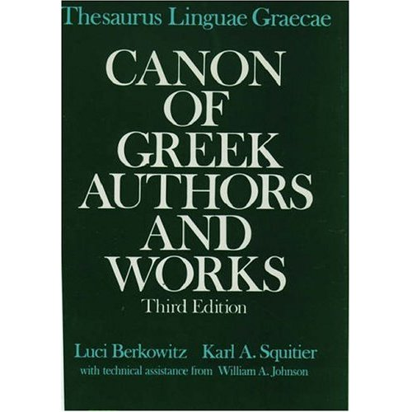
?
Notes:
By analogy, we have not updated our taxonomy of ancient literature by statistical means.
https://images-eu.ssl-images-amazon.com/images/I/51T04RR80HL._SS500_.jpg

Slide 62
Thanks!
Board of advisors
Prof. Neil Coffee, U at Buffalo
Prof. Gregory Crane, Universität Leipzig & Tufts U
Prof. Peter Meineck, NYU
Prof. Leonard Muellner, Brandeis University & Center for Hellenic Studies
Project leaders
Patrick J. Burns, PhD (ISAW, NYU)
Luke Hollis (Archimedes Digital)
Prof. Marius Jøhndal (U of Cambridge & Oslo)
Suhaib Khan (graduate of Netaji Subhas IT, Delhi, India)
Contact
kyle@kyle-p-johnson.com
http://cltk.org
Notes:
check everyone’s names!!!

